Slide 1

Enterprise-Scale Landing Zones Getting ready to deploy workloads on Azure

Slide 2
Agenda
Welcome & Logistics
Enterprise Scale Landing Zones - Enterprise Enrollment and Azure AD Tenants - Identity and Access Management - Management Group and Subscription Organization
Lunch Break - Network Topology and Connectivity - Security, Governance, and Compliance - Management and Monitoring - Business Continuity and Disaster Recovery - Platform Automation and DevOps
Q&A
Notes:
Key message – in this session we are going to cover a key element in your cloud journey and critical step to successfully deploy workloads on Azure.

Slide 3
Enterprise-scale?
Enterprise-scale is an architecture approach and reference implementation that enables effective construction and operationalization of landing zones on Azure, at scale and aligned with Azure Roadmap and Microsoft Cloud Adoption Framework for Azure.
Authoritative Provides holistic design decision framework for Azure Platform.
Proven
Based on success of large-scale migration projects at-scale.
Prescriptive Apply this on "Monday Morning" in your Azure environment.
Enterprise-scale Architecture:
Enterprise-scale design principles: Principles to help/guide you customize the design.
Enterprise-scale design guidelines: Guidelines (decisions and recommendations) for the 8 components of the enterprise-scale architecture
Enterprise-scale Implementation guide: The way you create those things using reference implementation in GitHub and the deployment pipeline
Enterprise-scale Reference Implementation:
Enterprise-scale foundation: A reference implementation of shared services containing network, security, identity, governance services required to construct and operationalize an enterprise-scale landing zone
Enterprise-scale landing zone(s): A reference implementation of a workload environment conforming to the enterprise-scale architecture (opinionated way to implement, code)
https://aka.ms/enterprisescale
Notes:
Enterprise-scale comes in two buckets
The Architecture – What must be true? This is our Microsoft opinion on what should be done based on really world work with our strategic customers.
The reference implementation – This is a first partner example on how this could be implemented. You do not have to use this reference implementation if you are following the design guidelines and principles.
In the rest of the session, we’ll discuss these 5 elements.

Slide 4
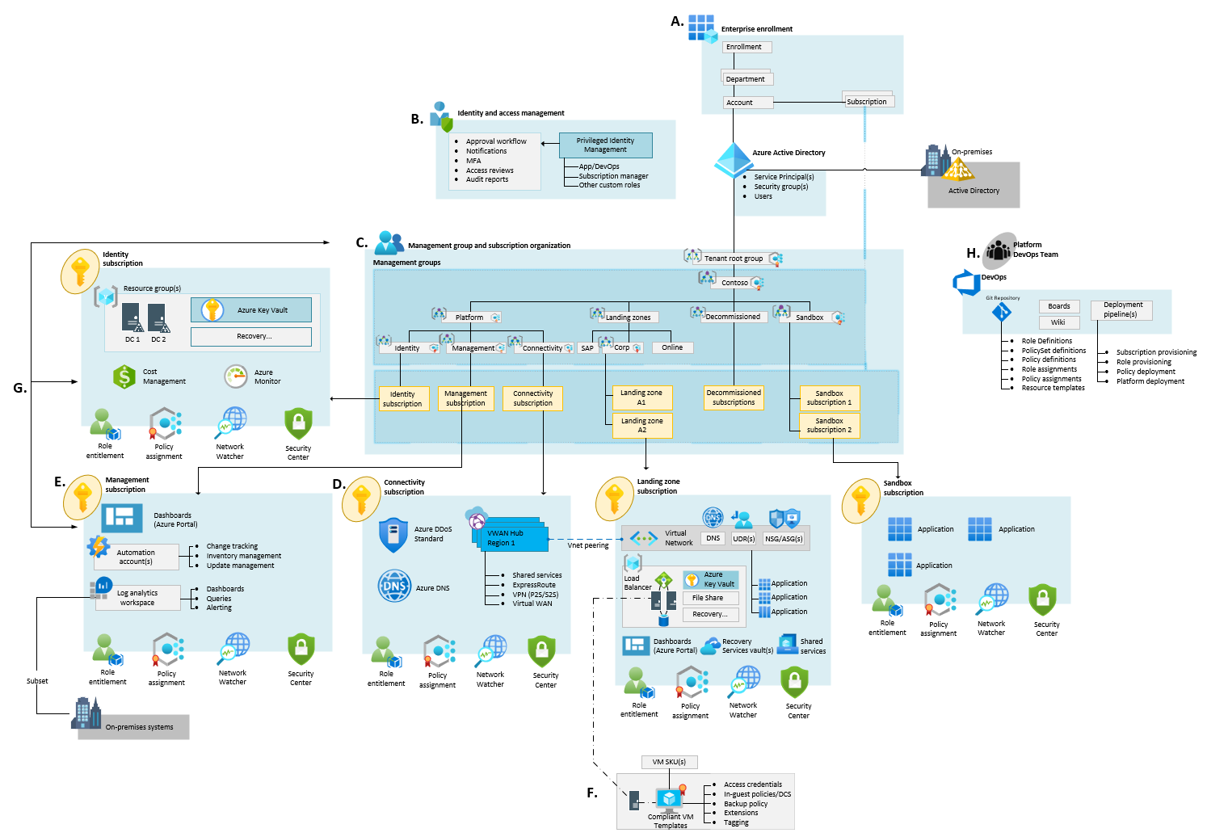
Architecture Composition

Slide 5
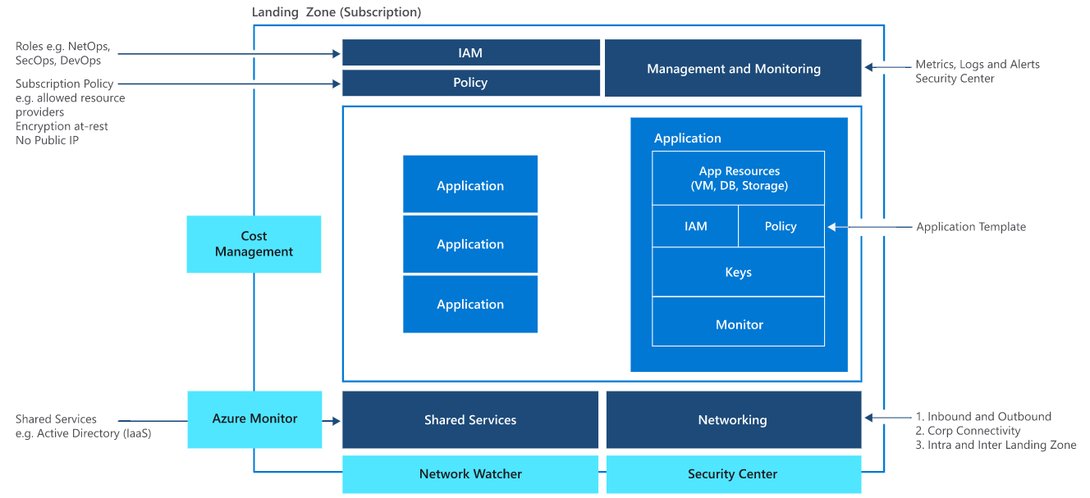
Landing Zones The principal purpose of a Landing Zone is to ensure that when an application lands on Azure, the required plumbing is already in place, providing greater agility and compliance with enterprise security and governance requirements

Slide 6
Enterprise-scale design principles
Subscription Democratization
Policy-Driven Governance
Single Control and Management Plane
Application-Centric and Archetype-Neutral
Azure Native Design and Platform Roadmap Alignment
Enable Autonomy for Innovation and Transformation
Security and Compliance By-Default
Governance At-Scale with Sustainable Cloud Engineering
Notes:
just like organizing book in library comes with set of principals. Enterprise scale come with set of design principal, which are necessary for organizing resources in subscriptions in enterprise
There is a purpose behind every single principal which will be discuss in the course of this presentation.
Subscriptions should be used as a unit of management and scale aligned with business needs and priorities. You should avoid to maintain central control for subscription creation, and allow business units to create subscriptions themselves. Your governance model should ensure that as subscriptions are created and moved to different management groups, policies are applied to enforce any necessary guardrails.
Azure Policy should be used to provide the “guard-rails” and ensure the continued compliance of the customer platform and applications deployed onto it, whilst also providing application owners sufficient freedom and a secure unhindered path to cloud.
The Enterprise-scale architecture should NOT rely on abstraction layers such as customer developed portals or tooling, and should provide a consistent experience for both AppOps (centrally managed operation teams) and DevOps (dedicated application operation teams).
The “North Star” architecture should focus on application centric migrations and development rather than a pure infrastructure “lift and shift” migration (i.e. movement of virtual machines) and should not differentiate between old/new applications or IaaS/PaaS applications.
The North Star architecture strongly advocates the use of native platform services and capabilities wherever possible, which should be fully aligned with Azure platform roadmaps from the offset to ensure new capabilities are swiftly made available within customer environments.

Slide 7
Critical design areas
Enterprise Enrolment and Azure AD Tenants
Identity and Access Management
Management Group and Subscription Organisation
Network Topology and Connectivity
Management and Monitoring
Business Continuity and Disaster Recovery
Security, Governance, and Compliance
Platform Automation and DevOps

Slide 8
Critical design areas
Enterprise Enrolment and Azure AD Tenants
Identity and Access Management
Management Group and Subscription Organisation
Network Topology and Connectivity
Management and Monitoring
Business Continuity and Disaster Recovery
Security, Governance, and Compliance
Platform Automation and DevOps
Notes:
Scope: The objective of this exercise is to evaluate the various offer types and Azure Active Directory tenant association is best suited for your overall environment
Out of scope: This design area references Active Directory or AD, but it doesn't focus on the identity or management aspects of Azure AD, only the tenant in which your identities will ultimately be hosted.

Slide 9
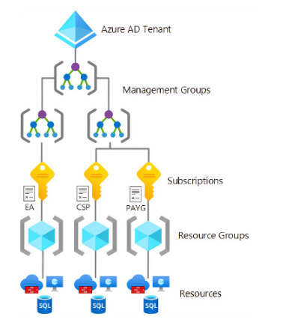
Azure Billing Offers and Azure AD Tenants
The Azure service presents a range of active subscription offers, and customers can use these offers at the same time to gain flexible billing options. Example subscriptions include Enterprise Agreement (EA), Microsoft Customer Agreement (MCA), Cloud Service Provider (CSP), and others
Considerations and recommendations for each approach below:
Enterprise Agreement (EA)
Microsoft customer agreement (MCA)
Cloud service provider agreement (CSP)
Notes:
This critical design area focuses on the two highest levels of alignment across all of your Azure deployments; your Azure billing offer and the association of that offer with an Azure Active Directory (Azure AD) tenant.
The objective of this exercise is to evaluate the various offer types and Azure Active Directory tenant association is best suited for your overall environment.
For instance EA supports multiple Azure tenants, but CSP and MCA don’t support

Slide 10

Enterprise Enrolment & Azure AD Tenants
An Azure subscription can only trust one Azure AD tenant at a time, further information can be found at Associate or add an Azure subscription to your Azure Active Directory tenant
Multiple Azure AD tenants can function in the same enrollment
Azure Lighthouse only supports delegation at the subscription and resource group scopes
The *.onmicrosoft.com domain name created for each Azure AD tenant must be globally unique as per the terminology section in what is Azure Active Directory?
The *.onmicrosoft.com domain name for each Azure AD tenant cannot be changed once created
Explore the authentication methods offered by Azure Active Directory as part of your Azure Active Directory tenant planning
Azure AD Tenants
Design Considerations

Slide 11
Azure AD Tenants
Enterprise Enrolment & Azure AD Tenants
Add one or more custom domains to your Azure AD tenant as per Add your custom domain name using the Azure Active Directory portal
Avoid creating multiple Azure AD tenants
Use Azure Lighthouse to grant third parties/partners access to Azure resources in customer Azure AD tenants and centralized access to Azure resources in multitenant Azure AD architectures
Plan for emergency access or break-glass accounts to prevent tenant-wide account lockout
Design Recommendation

Slide 12
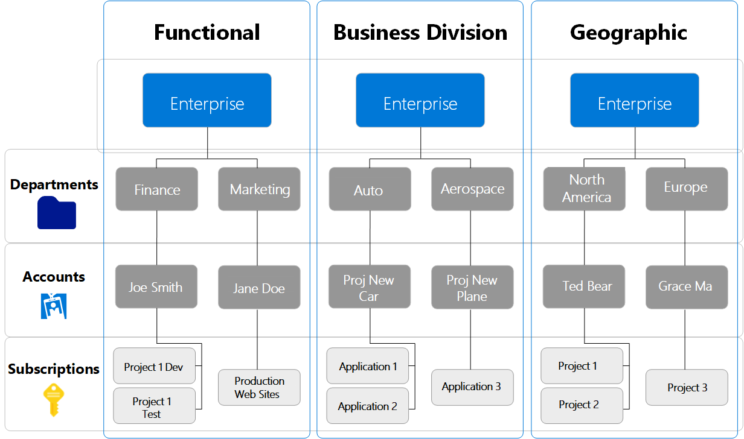
Plan for Enterprise Agreement Enrolment
Departments logical groupings can set a budget or quota​
Accounts are organizational units in the Azure enterprise portal​
Subscriptions are the smallest unit in the Azure enterprise portal
Notes:
Departments help to segment costs into logical groupings and set a budget or quota at the department level. The quota isn't firmly enforced; it's used for reporting purposes.
Accounts are organizational units in the Azure EA portal. They can be used to manage subscriptions and access reports.
Subscriptions are the smallest units in the Azure EA portal. They're containers for Azure services that are managed by a Service Administrator. This is where your organization deploys Azure services

Slide 13
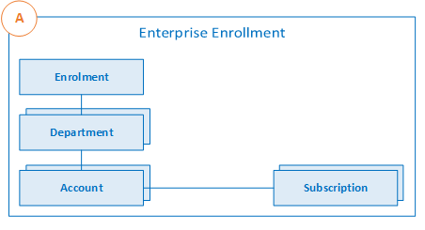
Enterprise Agreement Enrolment Roles
Enterprise enrollment roles links users with their functional role and consists of​
​
Enterprise Administrator​
Department Administrator​
Account Owner​
Service Administrator​
Notification Contact
Notes:
Enterprise Administrator: The person who manages departments, department owners, accounts, and account owners on Azure. They have the ability to manage enterprise administrators as well as view usage data, billed quantities, and unbilled charges across all accounts and subscriptions
Department administrator: The person who manages departments, creates new accounts and account owners, views usage details for the departments they manage, and can view costs when granted permission
Account Owner: The person who manages subscriptions and service administrators on Azure. They can view usage data on this account and its associated subscriptions.
Set up a Notification Contact email address to ensure notifications are sent to an appropriate group mailbox.
Subscriptions are managed by a Service Administrator. This is where your organization deploys Azure services

Slide 14
Enterprise Enrolment & Azure AD Tenants
The enrolment provides a hierarchical organizational structure to govern how subscriptions are managed. For more information, see Managing Azure Enterprise Agreement roles
A range of administrators can be assigned to a single enrolment
Each subscription should have a designated account owner. See Azure EA portal administration guide for details on how to change this, if needed
Each account owner is a subscription owner for any subscriptions provisioned under that account
Enterprise
Enrolment
Design Considerations

Slide 15
Enterprise Enrolment & Azure AD Tenants
A subscription can belong to only one account at a time
A specific set of criteria can be used to determine whether a subscription should be suspended
Departments and accounts can filter enrolment billing and usage reports
Enterprise
Enrolment
Design Considerations

Slide 16
Enterprise Enrolment
Enterprise Enrolment & Azure AD Tenants
Only use the authentication type Work or school account for all account types. Avoid using the Microsoft account (MSA) account type
Set up a Notification Contact email address to ensure notifications are sent to an appropriate group mailbox
An organization can have various structures, including functional, divisional, geographic, matrix, or team structures. Using departments and accounts to map your organization's structure to your enrollment hierarchy can help with separating billing
Design Recommendation

Slide 17
Enterprise Enrolment
Use Azure Cost Management + Billing reports and views, which can use Azure metadata (for example, tags and location) to explore and analyze your organization's costs
Restrict and minimize the number of account owners within the enrolment to limit administrator access to subscriptions and associated Azure resources
Assign a budget for each department and account, and establish an alert associated with the budget
Create a new department for IT if business domains have independent IT capabilities
If you use multiple Azure AD tenants, verify that the account owner is associated with the same tenant as where subscriptions for the account are provisioned
Enterprise Enrolment & Azure AD Tenants
Design Recommendation

Slide 18
Enterprise Enrolment
Enterprise Enrolment & Azure AD Tenants
For development/testing (dev/test) workloads, use the Enterprise Dev/Test offer, where available. Ensure you comply with the terms of use
Don't ignore notification emails sent to the notification account email address. Microsoft sends important Enterprise Agreement prompts to this account
Don't move or rename an Enterprise Agreement account in Azure AD
Periodically audit the Azure EA portal to review who has access, and when possible, avoid using a Microsoft account.
Design Recommendation

Slide 19
Questions?
Enterprise Enrolment & Azure AD Tenants
Notes:
KEY POINTS:

Slide 20
Critical design areas
Enterprise Enrolment and Azure AD Tenants
Identity and Access Management
Management Group and Subscription Organisation
Network Topology and Connectivity
Management and Monitoring
Business Continuity and Disaster Recovery
Security, Governance, and Compliance
Platform Automation and DevOps
Notes:
Scope: The goal of this critical design area is to evaluate options for your identity and access foundation. At minimum, you should make decisions about your approach for synchronizing identities with Azure Active Directory:
Authenticating users
Assigning access to resources
Any core requirements for separation of duties

Slide 21


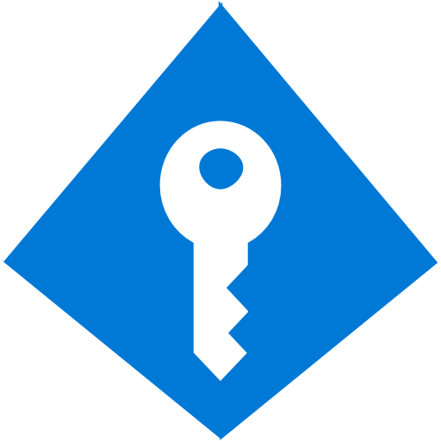







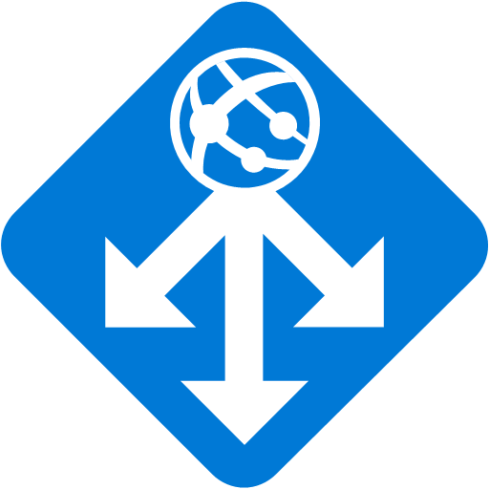





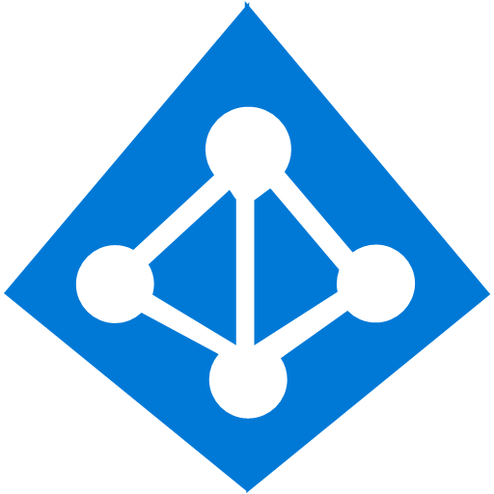

Identity and Access Management Use Cases
Azure AD Connect
B2B collaboration
Provisioning-Deprovisioning
Conditional Access
SSO to SaaS
Self-Service capabilities
Connect Health
Multi-Factor Authentication
I want to provide my employees secure and easy access to every application from any location and any device
Addition of custom cloud apps
Access Panel/MyApps
Dynamic Groups
Identity Protection
I want to quickly deploy applications to devices, do more with less and automate Join/Move/Leave processes
Remote Access to on-premises apps
Azure AD B2C
Group-Based Licensing
Privileged Identity Management
I need my customers and partners to access the apps they need from everywhere and collaborate seamlessly
Microsoft Authenticator - Password-less Access
Azure AD Join
MDM-auto enrollment /
Enterprise State Roaming
Security Reporting
I want to protect access to my resources from advanced threats
I need to comply with industry regulation and national data protection laws
Azure AD DS
Office 365 App Launcher
HR App Integration
Access Reviews
I want to write applications that work with my corporate identities in Azure Active Directory
Notes:
Identity provides the basis for a large percentage of security assurance. It grants access based on identity authentication and authorization controls in cloud services. Access control protects data and resources and helps decide which requests should be permitted.
Identity and access management (IAM) is boundary security in the public cloud. It must be treated as the foundation of any secure and fully compliant public cloud architecture. Azure offers a comprehensive set of services, tools, and reference architectures to help organizations make highly secure, operationally efficient environments as outlined here.
This section examines design considerations and recommendations related to IAM in a cloud environment.
The technological landscape in the enterprise is becoming complex and heterogenous. To manage compliance and security for this environment, IAM lets the right individuals access the right resources at the right time for the right reasons.

Slide 22

Identity & Access Management
Explore the authentication methods offered by Azure Active Directory as part of your identity planning
Applications that rely on domain services and use older protocols might be able to use Azure AD DS
There's a difference between Azure AD, Azure AD DS, and AD DS running on Windows Server. Evaluate your application needs, and understand and document the authentication provider that each one will be using. Plan then for all applications.
Azure Active
Directory
What are the Differences Between Azure Active Directory and Azure Active Directory Domain Services? (microsoft.com)
Design Considerations

Slide 23
Identity & Access Management
Role-based access control (RBAC):
Limits exist for the number of custom roles and role assignments that you must consider when you lay down a framework around IAM and governance. For more information, see Azure RBAC service limits
There's a limit of 2,000 role assignments per subscription
There's a limit of 500 role assignments per management group
Prerequisites for a Landing Zone
Design Considerations
Notes:
A critical design decision that an enterprise organization must make when adopting Azure is whether to extend a current on-premises identity domain into Azure or to create a brand new one.
Requirements for authentication inside the landing zone should be thoroughly assessed and incorporated into plans to deploy Active Directory Domain Services (AD DS) in Windows Server, Azure AD Domain Services (Azure AD DS), or both.
Most Azure environments will use at least Azure AD for Azure fabric authentication and AD DS local host authentication and group policy management.

Slide 24
Identity & Access Management
Managed identities
Which tasks and functions should the organization control with managed identities?
Which services or applications within your landing zone support Azure Active Directory authentication?
Explore which Azure services can use managed identities
Explore managed identities for Azure resources capabilities in further detail
Prerequisites for a Landing Zone
Design Considerations

Slide 25
Platform access:
Centralized versus federated resource ownership:
Shared resources or any aspect of the environment that implements or enforces a security boundary, such as the network, must be managed centrally. This requirement is part of many regulatory frameworks. It's standard practice for any organization that grants or denies access to confidential or critical business resources
Managing application resources that don't violate security boundaries can be delegated to application teams. Consider delegating other aspects that are required to maintain security and compliance as well. Letting users provision resources within a securely managed environment lets organizations:
Take advantage of the agile nature of the cloud
Prevent the violation of any critical security or governance boundary
Identity & Access Management
Identity for Azure Platform Resources
Design Considerations

Slide 26
Identity & Access Management
Platform access:
Depending on the definition of the centralized or federated resource ownership, custom roles might differ. The custom roles for the centralized resource ownership are limited and might need extra rights depending on the responsibility model
For example, in some organizations a NetOps role might only need to manage and configure global connectivity. But, in other organizations that need a more centralized approach, enrich the NetOps role with more allowed actions, like creating peering between the hub and the spokes
Identity for Azure Platform Resources
Design Considerations
Azure custom roles - Azure RBAC | Microsoft Docs

Slide 27
Identity & Access Management
Workload access:
Based on your cloud operating model, which teams will require access to workloads within the landing zone?
What roles or functions will those teams with access carry out?
What is the minimum level of privilege they would require to carry out their responsibilities?
Identity for Azure Platform Resources
Design Considerations

Slide 28
Identity & Access Management
Hosting infrastructure as a service (IaaS) identity solutions:
Does the organization need to extend a current on-premises Active Directory domain into Azure?
Are there applications that are partly hosted on-premises and partly hosted in Azure?
Identity for Azure Platform Resources
Design Considerations

Slide 29
Identity & Access Management
Use centralized and delegated responsibilities to manage resources deployed inside the landing zone based on role and security requirements
These types of privileged operations require special permissions:
Creating service principal objects
Registering applications in Azure AD
Procuring and handling certificates or wildcard certificates
Consider which users will be handling such requests and how to secure and monitor their accounts with the necessary diligence
If an organization has a scenario where an application that uses integrated Windows authentication must be accessed remotely through Azure AD, consider using Azure AD Application Proxy
Azure Active Directory
Design Recommendation

Slide 30
Identity & Access Management
Evaluate the compatibility of workloads for AD DS on Windows Server and for Azure AD DS
Ensure your network design allows resources that require AD DS on Windows Server for local authentication and management to access the appropriate domain controllers
For AD DS on Windows Server, consider shared services environments that offer local authentication and host management in a larger enterprise-wide network context
Deploy Azure AD DS within the primary region because this service can only be projected into one subscription. The Azure AD DS-managed domain can be expanded to further regions with replica sets
Use managed identities instead of service principals for authentication to Azure services. This approach reduces exposure to credential theft
Azure Active Directory
Design Recommendation

Slide 31
Identity & Access Management
Use Azure RBAC to manage data-plane access to resources, where possible. Examples are Azure Key Vault, a storage account, or an SQL database
Deploy Azure AD conditional-access policies for any user with rights to Azure environments. Doing so provides another mechanism to help protect a controlled Azure environment from unauthorized access
Enforce multifactor authentication for any user with rights to the Azure environments. Multifactor authentication enforcement is a requirement of many compliance frameworks. It greatly lowers the risk of credential theft and unauthorized access
Prerequisites for a Landing Zone
Design Recommendation
Notes:
Planning for Identity and Access Management begins with the Azure platform and Azure Active Directory. Many consider identity to be the primary perimeter for security. This is a shift from the traditional focus on network security. Network perimeters keep getting more porous, and that perimeter defense can’t be as effective as it was before the explosion of BYOD devices and cloud applications. Enterprise-scale recommendations focus on defining least privileged Role Based Access Control roles aligned to the customer’s operating model and leveraging Azure capabilities to apply additional layers of access control.
Use Azure AD Privileged Identity Management to establish zero standing access and to enable approval workflows for just-in-time control plane access to azure resources. Granting entitlements through PIM, rather than direct resource access, helps to protect against legacy access rights that often result from changing roles and responsibilities within an organization.
Use Azure AD PIM access reviews to periodically validate resource entitlements. Regularly scheduled reviews of access rights and entitlement use is a regulatory requirement for many customers. Determining which users had access to what resources for a given time period is much easier with PIM compared to querying AAD audit logs.
Customer RBAC roles should be used to define access rights across the Azure estate. Key roles within an organization will typically include Platform Owners, NetOps, SecOps, AppOps, and DevOps. Well defined and scoped RBAC role definitions enable subscription democratization through the segregation of duties required by an organization’s operating model.
Integrate Azure AD logs with the platform-central Azure Monitor Log Analytics workspace for audit reports and alert notifications.
Use Azure AD Managed Identities (MI) for Azure resources, avoiding username and password-based authentication. Managed Identities provide the simples and most secure method for enabling service to service communication. Managed Identities eliminate the need for credentials in your code, they rotate credentials automatically, and can be used to authenticate to any service that supports Azure AD authentication.
Multi-Factor Authentication should be enforced on all privileged accounts. If you only use a password to authenticate a user, it leaves an insecure vector for attack. If the password is weak or has been exposed elsewhere, is it really the user signing in with the username and password, or is it an attacker? When you require a second form of authentication, security is increased as this additional factor isn't something that's easy for an attacker to obtain or duplicate.
Conditional Access policies should be enforced on all privileged accounts. Azure Active Directory (Azure AD) Conditional Access (CA) analyses signals such as user, device, and location to automate decisions and enforce organizational access policies for resource. You can use CA policies to apply access controls like Multi-Factor Authentication (MFA). CA policies allow you to prompt users for MFA when needed for security and stay out of users’ way when not needed.
Planning for Authentication Inside the Landing Zone is concerned with workload access and dependencies on on-premises systems. A critical design decision enterprise organization must make when adopting Azure is whether to extend and existing on-premises identity domain into Azure or create a brand new one. Requirements for authentication inside the "Landing Zone" should therefore be thoroughly assessed and incorporated into plans to deploy AD, Azure AD-DS or both.
Examples:
Use AAD RBAC to manage data plane access to resources where possible (e.g. Key Vault, Storage Account, Azure SQL DB). Use Managed Identities instead of Service Principles for authentication to Azure services.
Evaluate the compatibility of workloads for AD and AAD-DS. Do not assume existing workloads are agnostic of AD and AAD-DS authentication, as there are differences between both approaches.
Deploy AAD-DS within the primary region as this service can be projected into only one subscription. Use Virtual Network Peering to support its usage as an authentication service.
Use Just-In-Time access for both VM access and Azure control plane administration.
Knowledge Check
Where should Azure Control Plane Groups live?
a.) On-Premise AD – The group will not be able to
b.) On-premise AD synced to Azure AD
c.) Azure AD only – You are managing your control plane on Azure only, so having this group on premise creates overhead with no functional benefit. Always create groups in Azure AD if they don’t manage anything on premise.
How should resource to resource authentication occur?
a.) By using Managed Services Identities - The feature provides Azure services with an automatically managed identity in Azure AD. You can use the identity to authenticate to any service that supports Azure AD authentication, including Key Vault, without any credentials in your code.
b.) By using Password Based Authentication – this is a static method and not best practice as securely storing these credentials creates management overhead
c.) Use Azure Key Vault – key vault provides storage to your keys and secrets but it’s not responsible for initiating authentication

Slide 32
Identity & Access Management
Don't add users directly to Azure resource scopes. Instead add users to defined roles, which are then assigned to resource scopes. Direct user assignments circumvent centralized management, greatly increasing the management required to prevent unauthorized access to restricted data
Use custom role definitions within the Azure AD tenant while you consider the following key roles:
Prerequisites for a Landing Zone
Design Recommendation

Slide 33
Create custom RBAC Roles only when necessary
Role | Usage | Actions: | No Actions:
Azure Platform Owner | Management Group and Subscription lifecycle management | *
Network Management (NetOps) | Platform wide Global Connectivity management; VNets, UDRs, NSGs, NVAs, VPN, ER etc. | */read, Microsoft.Authorization/*/write, Microsoft.Network/vpnGateways/*, Microsoft.Network/expressRouteCircuits/*, Microsoft.Network/routeTables/write, Microsoft.Network/vpnsites/*
Security Operations (SecOps) | Security Administrator role with a horizontal view across the entire Azure estate and the KV Purge Policy | */read, */register/action, Microsoft.KeyVault/locations/deletedVaults/purge/action, Microsoft.Insights/alertRules/*, Microsoft.Authorization/policyDefinitions/*, Microsoft.Authorization/policyassignments/*, Microsoft.Authorization/policysetdefinitions/*, Microsoft.PolicyInsights/*,Microsoft.Security/*
Subscription Owner | Delegated Role for Subscription Owner derived from subscription Owner role | * | Microsoft.Authorization/*/write, Microsoft.Network/vpnGateways/*, Microsoft.Network/expressRouteCircuits/*, Microsoft.Network/routeTables/write, Microsoft.Network/vpnsites/*
Application Owners DevOps/AppOps | Contributor role granted for application/operations team at resource group level |  | Microsoft.Network/publicIPAddresses/write, Microsoft.Network/virtualNetworks/write, Microsoft.KeyVault/locations/deletedVaults/purge/action
Notes:
There should be a handful/limited amount of custom roles for specific functions within an organization. Having custom roles in excess is an anti-cloud pattern. Below are some example roles that define the
Scope of responsibility for the corresponding teams. This is not a definitive list and rather a guideline for discussing with the customer how azure will be administered day to day.
Azure Platform Owner
- limited to teams who are managing both the resource group and subscription
Network Management
broad role granting access to all network services
Allocated to team responsible for network operations
Security Operations (SecOps)
- Responsible for securing administration and compliance
Subscription Owner
This role iterates on the built in role by giving the ability to restrict the subscription owner
E.G. – An application lead who is a subscription owner
You can also restrict them from Microsoft Authorization
E.G Prevent users with this role from modifying policies or denying access to route tables which would could pose a security risk)
Application Owners (DevOps/SecOps)
Access granted at the resource group level for provisioning and managing the lifecycle of the resources created.
Should identify the maturity of the customer. Whether the organization has a DevOps or AppOps Team
DevOps – owned by application owner
AppOps – owned by a designated platform team, sometimes outsource (e.g MSP)
Knowledge Check:
1.) It’s best practice to create as many custom roles as possible
a.) True
b.) False - Custom roles should only be assigned as needed for specific use cases for your organization as built-in policies already cover most scenarios
1.) It’s best practice Subscription owners should have contributor rights to Microsoft Authorization rights
a.) True
b.)False - Subscription owners should have contributor rights to resources within the subscription that are not centrally shared. Granting Microsoft Authorization which is centrally managed will allow the owner modify permissions that limit their scope, remove separation, and could pose security risks.

Slide 34
Identity & Access Management
Use Azure AD-managed identities for Azure resources to avoid authentication based on usernames and passwords. Many security breaches of public cloud resources originate with credential theft embedded in code or other text sources. For this reason, enforcing managed identities for programmatic access greatly reduces the risk of credential theft.
Use Azure AD Privileged Identity Management (PIM) to establish zero-standing access and least privilege. Map your organization's roles to the minimum level of access needed. Azure AD PIM can:
Be an extension of current tools and processes
Use Azure native tools as outlined
Use both as needed
Prerequisites for a Landing Zone
Design Recommendation

Slide 35
Identity & Access Management
Use Azure AD PIM access reviews to periodically validate resource entitlements. Access reviews are part of many compliance frameworks. As a result, many organizations will already have a process in place to address this requirement
Use privileged identities for automation runbooks that require elevated access permissions. Automated workflows that violate critical security boundaries should be governed by the same tools and policies users of equivalent privilege are
Prerequisites for a Landing Zone
Design Recommendation
Notes:
The need for access to privileged Azure resource and Azure AD roles by employees changes over time. To reduce the risk associated with stale role assignments, you should regularly review access. You can use Azure Active Directory (Azure AD) Privileged Identity Management (PIM) to create access reviews for privileged access to Azure resource and Azure AD roles. You can also configure recurring access reviews that occur automatically. This article describes how to create one or more access reviews.

Slide 36
Identity & Access Management
Platform access:
Use Azure AD-only groups for Azure control-plane resources in Azure AD PIM when you grant access to resources
Add on-premises groups to the Azure AD-only group if a group management system is already in place
By using Azure AD-only groups, you can add both users and groups that are synchronized from on-premises, via Azure AD Connect. You can also add Azure AD-only (also known as cloud only) users and groups to a single Azure AD-only group, including guest users.
Also, groups that are synchronized from on-premises can only be managed and updated from the identity source of truth (on-premises Active Directory). These groups can only contain members from the same identity source, which doesn't provide flexibility like Azure AD-only groups do
Identity for Azure platform resources
Design Recommendation

Slide 37
Identity & Access Management
Platform access:
Integrate Azure AD logs with the platform-central Log Analytics workspace. It allows for a single source of truth around log and monitoring data in Azure, which gives organizations cloud-native options to meet requirements around log collection and retention
If any data sovereignty requirements exist, custom user policies can be deployed to enforce them
Identity for Azure platform resources
Design Recommendation

Slide 38
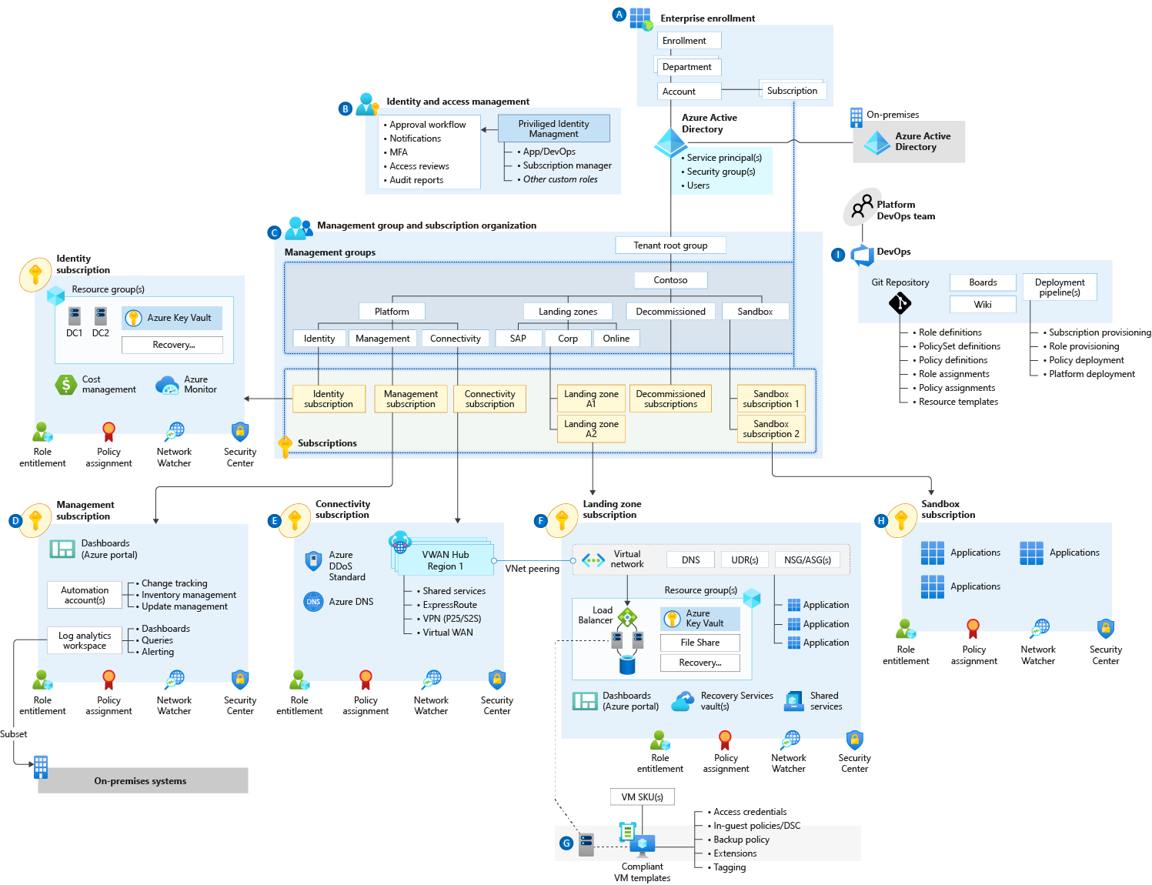
Identity & Access Management
Privileged Identity Management
Multi-Factor Authentication
Conditional Access (with GPS-based name locations)
Demo
Notes:
Privileged Identity Management provides time-based and approval-based role activation to mitigate the risks of excessive, unnecessary, or misused access permissions on resources that you care about. Here are some of the key features of Privileged Identity Management:
Provide just-in-time privileged access to Azure AD and Azure resources
Assign time-bound access to resources using start and end dates
Require approval to activate privileged roles
Enforce multi-factor authentication to activate any role
Use justification to understand why users activate
Get notifications when privileged roles are activated
Conduct access reviews to ensure users still need roles
Download audit history for internal or external audit
Prevents removal of the last active Global Administrator and Privileged Role Administrator role assignments
Conditional Access policies are enforced after first-factor authentication is completed. Conditional Access isn't intended to be an organization's first line of defense for scenarios like denial-of-service (DoS) attacks, but it can use signals from these events to determine access.
Requiring multi-factor authentication for users with administrative roles
Requiring multi-factor authentication for Azure management tasks
Blocking sign-ins for users attempting to use legacy authentication protocols
Requiring trusted locations for Azure AD Multi-Factor Authentication registration
Blocking or granting access from specific locations
Blocking risky sign-in behaviors
Requiring organization-managed devices for specific applications

Slide 39
Identity & Access Management
Questions?
Notes:
Sample RBAC roles: Owner, NetOps, SecOps, DevOps

Slide 40
Critical design areas
Enterprise Enrolment and Azure AD Tenants
Identity and Access Management
Management Group and Subscription Organisation
Network Topology and Connectivity
Management and Monitoring
Business Continuity and Disaster Recovery
Security, Governance, and Compliance
Platform Automation and DevOps

Slide 41
Architecture Composition

Slide 42

How will your organization separate out services owned or operated by specific teams?
Are there specific functions that need to be kept separate for business or operational compliance reasons?
Use Management Group structure within an AAD tenant to support org mapping
Must be appropriately considered when planning Azure adoption at-scale
A management group tree can support up to six levels of depth
All new subscriptions will be placed under the tenant root management group by default
Management Group & Subscription Organization
Management Groups
Design Considerations
Notes:
KEY POINTS:

Slide 43
Management Group & Subscription Organization
Azure Management Groups provide a way to efficiently manage access, policies, and compliance across an enterprise through a hierarchy made up of management groups and subscriptions.
Keep the management group hierarchy reasonably flat, ideally with no more than three to four levels
Create management groups under your root-level management group to represent the types of workloads that you'll host. These groups are based on the security, compliance, connectivity, and feature needs of the workloads
Use resource tags to query and horizontally navigate
Create a platform management group under the root management group to support common platform policy and Azure role assignment
Configure a default, dedicated management group for new subscriptions
Define a Management Group Hierarchy
Design Recommendation
Notes:
Talking Points
Design considerations:
Management groups can be used to aggregate policy and initiative assignments via Azure Policy.
A management group tree can support up to six levels of depth. This limit doesn't include the root or subscription level.
Design recommendations:
Keep the management group hierarchy reasonably flat with no more than three to four levels, ideally. This reduces management overhead and complexity.
Avoid duplicating your organizational structure into a deeply nested management group hierarchy. Management groups should be used for policy assignment versus billing purposes. This necessitates using management groups for their intended purpose in enterprise-scale architecture, which is providing Azure policies for workloads that require the same type of security and compliance under the same management group level.
Create management groups under your root-level management group to represent the types of workloads (archetype) that you'll host and ones based on their security, compliance, connectivity, and feature needs. This allows you to have a set of Azure policies applied at the management group level for all workloads that require the same security, compliance, connectivity, and feature settings.
Use resource tags, which can be enforced or appended through Azure Policy, to query and horizontally navigate across the management group hierarchy. This facilitates grouping resources for search needs without having to use a complex management group hierarchy.
Create a top-level sandbox management group to allow users to immediately experiment with Azure. This allows users to experiment with resources that might not yet be allowed in production environments and provides isolation from your development, test, and production environments.
Use a dedicated service principal name (SPN) to execute management group management operations, subscription management operations, and role assignment. This reduces the number of users who have elevated rights, following least-privilege guidelines.
Assign the User Access Administrator Azure RBAC role at the root management group scope (/) to grant the SPN mentioned above access at the root level. After the SPN is granted permissions, the User Access Administrator role can be safely removed. This ensures only the SPN is part of the User Access Administrator role.
Assign Contributor permission to the SPN mentioned above at the root management group scope (/), which allows tenant-level operations. This ensures that the SPN can be used to deploy and manage resources to any subscription within your organization.
Create a Platform management group under the root management group to support common platform policy and role-based access control (RBAC) assignment. This ensures that different policies can be applied to the subscriptions used for your Azure foundation, and that the billing for common resources is centralized in one set of foundational subscriptions.
Limit the number of Azure Policy assignments made at the root management group scope (/). This minimizes debugging inherited policies in lower-level management groups.
Do not create any subscriptions under the root management group. This ensures that subscriptions don't only inherit the small set of Azure policies assigned at the root-level management group, which don't represent a full set necessary for a workload.

Slide 44
Management Group & Subscription Organization
Subscriptions provide a management boundary for governance and isolation, which clearly separates concerns
Subscriptions serve as a scale unit so that component workloads can scale within the platform subscription limits
Subscription organization and governance
Design Considerations
Notes:
KEY POINTS:

Slide 45
Management Group & Subscription Organization
Subscriptions are a unit of management, billing, and scale within Azure, and they play a critical role when designing for large-scale Azure adoption.
Treat subscriptions as a unit of management that's aligned with your business needs and priorities
Make subscription owners aware of their roles and responsibilities and take full ownership of budget spending
Do an access review in Azure AD Privileged Identity Management on a quarterly or yearly basis. As a result, it will ensure that privileges don't proliferate
Ensure policy compliance and remediate when necessary
Avoid a rigid subscription model, and opt for a set of flexible criteria to group subscriptions across the organization
Subscription Organization and Governance
Design Recommendation
Notes:
Talking Points
Design recommendations:
Treat subscriptions as a democratized unit of management aligned with business needs and priorities.
Make subscription owners aware of their roles and responsibilities:
Perform an access review in Azure AD Privileged Identity Management quarterly or twice a year to ensure that privileges don't proliferate as users move within the customer organization.
Take full ownership of budget spending and resource utilization.
Ensure policy compliance and remediate when necessary.
Use the following principles when identifying requirements for new subscriptions:
Scale limits: Subscriptions serve as a scale unit for component workloads to scale within platform subscription limits. For example, large specialized workloads such as high-performance computing, IoT, and SAP are all better suited to use separate subscriptions to avoid limits (such as a limit of 50 Azure Data Factory integrations).
Management boundary: Subscriptions provide a management boundary for governance and isolation, allowing for a clear separation of concerns. For example, different environments such as development, test, and production are often isolated from a management perspective.
Policy boundary: Subscriptions serve as a boundary for the assignment of Azure policies. For example, secure workloads such as PCI typically require additional policies to achieve compliance, and this additional overhead doesn't need to be considered holistically if a separate subscription is used. Similarly, development environments may have more relaxed policy requirements relative to production environments.
Target network topology: Virtual networks can't be shared across subscriptions, but they can connect with different technologies such as virtual network peering or ExpressRoute. Therefore, it's important to consider which workloads must communicate with each other when deciding if a new subscription is required.
Group subscriptions together under management groups aligned within the management group structure and policy requirements at scale. This ensures that subscriptions with the same set of policies and RBAC assignments can inherit them from a management group, avoiding duplicate assignments.
Establish a dedicated management subscription in the Platform management group to support global management capabilities such as Azure Monitor Log Analytics workspaces and Azure Automation runbooks.
Establish a dedicated identity subscription in the Platform management group to host Windows Server Active Directory domain controllers, when necessary.
Establish a dedicated connectivity subscription in the Platform management group to host an Azure Virtual WAN hub, private DNS, ExpressRoute circuit, and other networking resources. This ensures that all foundation network resources are billed together and isolated from other workloads.
Avoid a rigid subscription model, opting instead for a set of flexible criteria to group subscriptions across the organization. This ensures that as your organization's structure and workload composition changes, you're able to create new subscription groups instead of using a fixed set of existing subscriptions. One size doesn't fit all for subscriptions; what works for one business unit may not work for another. Some apps may coexist within the same landing zone subscription while others may require their own subscription.

Slide 46
Management Group & Subscription Organization
Consider limits and quotas within the Azure platform for each service that your workloads require.
Subscription quotas are not capacity guarantees and are per region
Consider the availability of required SKUs in chosen Azure regions
Subscription quotas and capacity
Design Considerations
Notes:
KEY POINTS:

Slide 47
Management Group & Subscription Organization
When considering an enterprise-scale Azure adoption involving large resource quantities, ensure that sufficient capacity and SKUs are available, and the attained capacity can be understood and monitored.
Subscription Quotas and Capacity
Design Recommendation
Notes:
Talking Points
Design considerations:
Consider limits and quotas within the Azure platform for each service that your workloads require.
Consider the availability of required SKUs within chosen Azure regions. For example, new features might be available only in certain regions. The availability of certain SKUs for given resources such as VMs may be different from one region to another.
Consider that subscription quotas aren't capacity guarantees and are applied on a per-region basis.
Design recommendations:
Use subscriptions as scale units and scale out resources and subscriptions as required. This ensures that your workload can use the required resources for scaling out, when needed, without hitting subscription limits in the Azure platform.
Use reserved instances to prioritize reserved capacity in required regions. This ensures that your workload will have the required capacity even when there's a high demand for that resource in a specific region.
Establish a dashboard with custom views to monitor utilized capacity levels. Set up alerts if capacity utilization is reaching critical levels (for example, 90 percent CPU utilization).
Raise support requests for quota increase as a part of subscription provisioning (for example, total available VM cores within a subscription). This ensures your quota limits are set before your workloads require going over the default limits.
Ensure required services and features are available within the chosen deployment regions.

Slide 48
Management Group & Subscription Organization
A naming and tagging strategy includes business and operational details as components of resource names and metadata tags:
The business side of this strategy ensures that resource names and tags include the organizational information you need to identify the teams. Use a resource along with the business owners who are responsible for resource costs.
The operational side ensures that names and tags include necessary information to identify the workload, application, environment, criticality, and other information useful for managing resources
Naming and tagging
Design Considerations
Notes:
KEY POINTS:

Slide 49
Management Group & Subscription Organization
Define a naming convention. Use our naming convention and abbreviation recommendations
Define a tagging strategy: to include context about the resource's associated workload or application, operational requirements, and ownership information. Use our suggested tags depending on your business needs.
IT or business teams use this information to find resources or generate reports about resource usage and billing
Naming and tagging
Design Recommendation
Notes:
Talking Points
Design considerations:
Potential need for chargeback models where shared platform as a service (PaaS) resources are concerned, such as Azure App Service Environment and Azure Kubernetes Service, which may need to be shared to achieve higher density.
Use a shutdown schedule for nonproduction workloads to optimize costs.
Use Azure Advisor to check cost optimization recommendations.
Design recommendations:
Use Azure Cost Management for cost aggregation and make it available to application owners.
Use Azure resource tags for cost categorization and resource grouping. This allows you to have a chargeback mechanism for workloads that share a subscription or for a given workload that spans across multiple subscriptions.

Slide 50
Management Group & Subscription Organization
Finding the structure of tags that fits your cost and recharging model might help track your cloud spend
Azure pricing calculator can be used to estimate the expected monthly costs
Azure Hybrid Benefit might help reduce the costs of running your workloads in the cloud
Azure Reservations helps you save money by committing to one-year or three-year plans for multiple products
Azure policies can be used to allow specific regions, resource types, and resource SKUs.
Azure Storage lifecycle management offers a rule-based police
Azure dev/test subscriptions give you access to select Azure services for nonproduction workloads at discounted pricing.
Use autoscaling to save costs by dynamically allocating and de-allocating resources
Using Azure spot virtual machines allows you to take advantage of our unused capacity at a significant cost savings
Cost Management
Design Considerations
Notes:
KEY POINTS:

Slide 51
Management Group & Subscription Organization
Plan accordingly and choose Azure Reservations, the right SKUs, Hybrid Benefit, Dev/Test subscriptions or Spot VMs according to your needs
Use Azure Cost Management + Billing to implement financial oversight on resources in your environment.
Use tags in Azure to append metadata to resources, which might enable granular analysis of spend (such as cost center or project name)
Shutdown schedule for non-prod workloads to optimize costs
Use Azure Advisor to check cost optimization recommendations
Potential need for chargeback models where shared PaaS services are concerned, such as ASE which may need to be shared to achieve higher density
Cost Management
Design Recommendation
Notes:
Talking Points
Design considerations:
Potential need for chargeback models where shared platform as a service (PaaS) resources are concerned, such as Azure App Service Environment and Azure Kubernetes Service, which may need to be shared to achieve higher density.
Use a shutdown schedule for nonproduction workloads to optimize costs.
Use Azure Advisor to check cost optimization recommendations.
Design recommendations:
Use Azure Cost Management for cost aggregation and make it available to application owners.
Use Azure resource tags for cost categorization and resource grouping. This allows you to have a chargeback mechanism for workloads that share a subscription or for a given workload that spans across multiple subscriptions.

Slide 52
ESLZ Example:

Slide 53
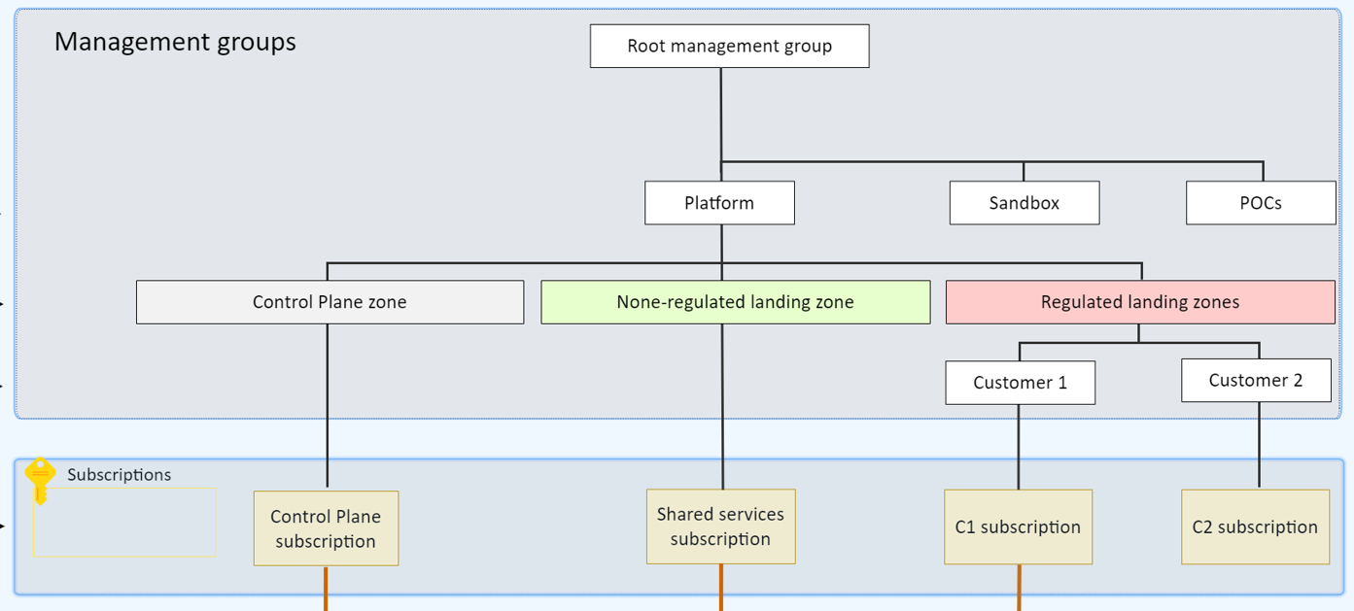
Custom draft:
Notes:
intermediate MG
Landing zones within Platform MG – Why? Do they share the same Security, Compliance, and Access Control?

Slide 54
Management Group & Subscription Organization
Questions?
Notes:
Talking Points
Design considerations:
Potential need for chargeback models where shared platform as a service (PaaS) resources are concerned, such as Azure App Service Environment and Azure Kubernetes Service, which may need to be shared to achieve higher density.
Use a shutdown schedule for nonproduction workloads to optimize costs.
Use Azure Advisor to check cost optimization recommendations.
Design recommendations:
Use Azure Cost Management for cost aggregation and make it available to application owners.
Use Azure resource tags for cost categorization and resource grouping. This allows you to have a chargeback mechanism for workloads that share a subscription or for a given workload that spans across multiple subscriptions.

Slide 55
Critical design areas
Enterprise Enrolment and Azure AD Tenants
Identity and Access Management
Management Group and Subscription Organisation
Network Topology and Connectivity
Management and Monitoring
Business Continuity and Disaster Recovery
Security, Governance, and Compliance
Platform Automation and DevOps

Slide 56

Network Topology & Connectivity
What Azure Networking Topology to use?
Azure VWAN (Microsoft Managed)
Traditional Azure Vnet (Customer Managed)
Planning for IP Addressing?
What Connectivity to Azure to use?
On-premises <> Azure
To Azure PaaS
Application Delivery
Network Security
Segmentation
Network Encryption
Resources
DNS
VM Access
What to consider?
Notes:
Network topology and connectivity within Enterprise-scale addresses the need for establishing the end-to-end connectivity for all landing zones in the enterprise Azure estate. The subject is both broad and complex and will likely consume a significant portion of the overall design effort.
1 - Planning for IP Addressing is the vital first step of Enterprise-scale network design. Many enterprises are IP constrained and having a detailed plan incorporated into the network design at the outset will help prevent a painful redesign and migration exercise. Key considerations include overlapping address ranges, Azure default IP consumption, IPv6, and Azure services requiring dedicated subnets.
2 - DNS Configuration within Enterprise-scale will be primarily influenced by the cross-premises name resolution requirements of landing zone workloads. For environments where name resolution in Azure is all that is required, native Azure DNS services should be enough. For environments where name resolution across Azure and on-premises is required, Azure VMs integrated with existing DNS infrastructure will be required. Integration with Private Link and services with special DNS requirements, such as OpenShift, must also be factored into the design.
3 - Azure Networking Topology
Azure Virtual WAN An Azure networking topology based-on Azure Virtual WAN is the preferred Enterprise Scale approach for large scale multi-region deployments where the customer needs to interconnect all their global locations on both Azure and on-premises. Azure Virtual WAN provides multiple advantages over traditional Azure networking, including:
Traditional Azure Vnet can also be used to build a secure network foundation aligned to the Enterprise Scale design principles. A traditional Azure networking topology should be used for customers that either:
4 – Connectivity - Main considerations
To Azure is concerned with establishing private connectivity from on-premises locations to Azure. Private connectivity options include ExpressRoute, ExpressRoute Global Reach, ExpressRoute Direct, Site-to-Site VPN, and Point-to-Site VPN. In order to decide which is the best/recommended, it is necessary to fully understand the various connectivity scenarios to align feature capabilities with your requirements.
To Azure PaaS services can come in many forms, and each service in the customer's Azure estate should be examined to ensure your requirements are met by the connectivity design. Azure PaaS services are typically accessed over public endpoints, though many PaaS services provide capabilities to secure such endpoints or even make them entirely private. Key service to achieve a fully private access to most of the services is to use Private Link.
Inbound and Outbound Internet Connectivity often involves separating customers from our customers from their existing on-premises tools and practices. A very common example is when customers want to force tunnel egress traffic back on-premises for inspection or replicate on-premises DMZ architectures in Azure.
Application Delivery focuses on application delivery within the landing zone. From the Enterprise-scale perspective, application delivery services, such as Application Gateway and Front Door, are an application component and should reside within the landing zone and be managed by the application owners. By leverage Azure Policy to ensure complaint service configuration, customers can maintain central governance while enabling the business.
Landing Zone Network Segmentation this section explores key recommendations to deliver highly secure internal network segmentation within a "Landing Zone" to drive a network Zero Trust implementation.
Network Encryption this section explores key recommendations to achieve network encryption between on-premises and Azure as well as across Azure regions.
Traffic Inspection - In many industries customers require that traffic in Azure, particularly inbound and outbound internet traffic, is mirrored to a network packet collector for deep inspection and analysis. This section therefore explores key considerations and recommended approaches for mirroring or tapping traffic within Azure Virtual Networks.

Slide 57
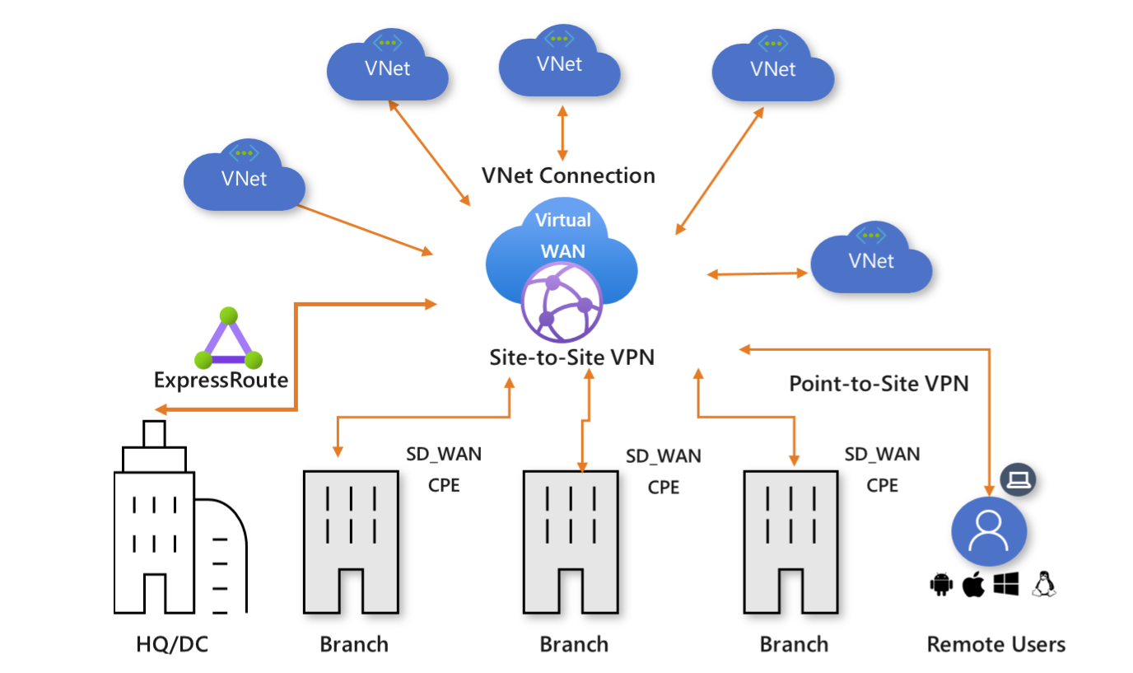
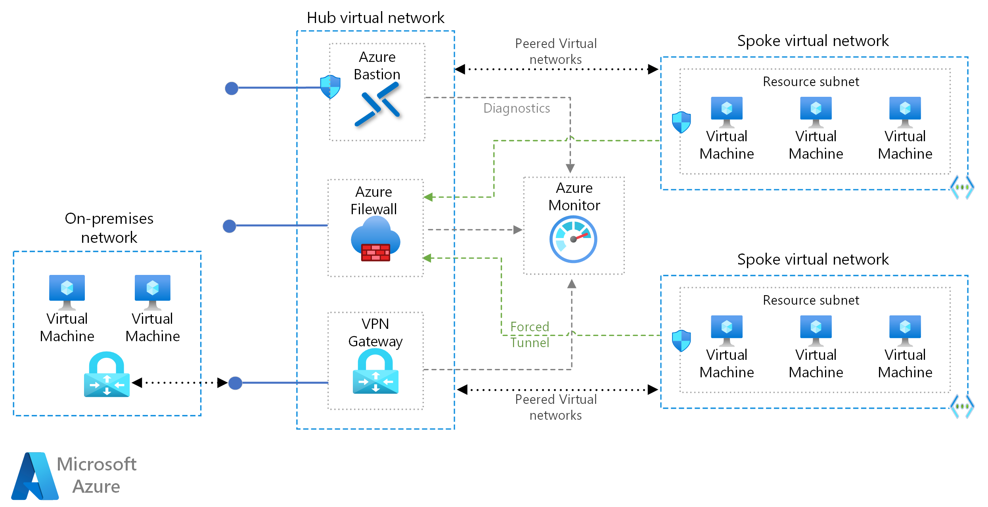
Networking Topology - Azure Virtual WAN vs Hub-Spoke?
Azure Virtual WAN Hub-Spoke
Microsoft-managed service
Resources across several Azure regions and requires global connectivity between VNets in these Azure regions
Integration of a large-scale branch network directly into Azure (SD-WAN or > 30 branch sites with VPN)
Requirement of transitive routing between VPN and Express Route
Customized secure large-scale networks
Resources in one or several Azure regions and branches and transitive connectivity is not required
Low number of remote or branch locations (<30 VPN)
Full control and granularity of Azure network routing policy

Slide 58
Network Topology & Connectivity
Virtual networks can't traverse subscription boundaries. However, connectivity is possible with virtual network peering
Virtual network peering is the preferred method to connect virtual networks in Azure
Virtual network peering isn't transitive. User-defined routes (UDRs) and network virtual appliances (NVAs) are required
An Azure DDoS Protection Standard protection plan can be shared across all virtual networks in a single Azure AD tenant to protect resources with public IP addresses
When multiple ExpressRoute circuits are connected to the same virtual network, use connection weights and BGP techniques to ensure an optimal path
Network Topology Hub & Spoke
Design Considerations
Notes:
KEY POINTS:

Slide 59
Network Topology & Connectivity
This configuration allows for appropriate traffic control to meet most requirements for segmentation and inspection:
Use Virtual Network Peering for hub-to-spoke connectivity
Use spoke-to-spoke connectivity via Azure Firewall/3rd party NVA and UDRs
Use cross-premises connectivity via ExpressRoute
Internet-outbound protection via Azure Firewall/3rd party NVA
Deploy a set of minimal shared services, including ER/VPN gateways, Azure Firewall/3rd party NVA in the central-hub virtual network. If necessary, also deploy AD domain controllers and DNS servers
Deploy Azure Firewall/3rd party NVAs for east/west or south/north traffic protection and filtering, in the central-hub virtual network
Don't deploy Layer 7 inbound NVAs, such as Azure Application Gateway, as a shared service in the central-hub virtual network. Instead, deploy them together with the application in their respective landing zones
Deploy a single Azure DDoS standard protection plan in the connectivity subscription
Two limits must be considered when you connect spoke virtual networks to the central hub virtual network:
The maximum number of virtual network peering connections per virtual network (500)
The maximum number of prefixes that ExpressRoute with private peering advertises from Azure to on-premises (600)
Networking Topology Hub & Spoke
Notes:
While Virtual WAN offers a wide range of powerful capabilities, there are some cases where a traditional Azure Vnet approach may be optimal – for example:
If a global transitive network across multiple Azure regions or cross-premises isn't required, such as a branch in the United States requiring connectivity to a virtual network in Europe, go with Vnet.
If there isn't a need to connect to a large number of remote locations via VPN or integration with an SD-WAN solution, use Vnet.
If the customer's preference is to have granular control and configuration when setting up a network topology in Azure, again use Vnet and not Vwan.

Slide 60
Network Topology & Connectivity
Overlapping IP address spaces across on-premises and Azure regions creates major contention challenges
You can add address space after you create a virtual network, without an outage. However, every virtual network peering needs a resync after the network space has changed
Azure reserves five IP addresses within each subnet. Factor in those addresses when you're sizing virtual networks and encompassed subnets
Some Azure services require dedicated subnets. These services include Azure Firewall and Azure VPN Gateway
IP Address Planning
Design Considerations
Notes:
KEY POINTS:

Slide 61
Network Topology & Connectivity
Plan for non-overlapping IP address spaces across Azure regions and on-premises locations in advance
Use IP addresses from the address allocation for private internet, known as RFC 1918 addresses
Don't use the following address ranges:
224.0.0.0/4 (multicast)
255.255.255.255/32 (broadcast)
127.0.0.0/8 (loopback)
169.254.0.0/16 (link-local)
168.63.129.16/32 (internal DNS)
Don't create large virtual networks like /16 or too small like /29. It ensures that IP address space isn't wasted, and it prevents management overhead. Plan the required address space in advance
IP Addressing
Design Recommendation
Notes:
1 - IP Addressing
The image shows an on prem network at 10.100.0.0/16 with an azure region assigned 10.200.0.0/16 and the hub and spokes carved out as /24s.
Tip: One customer assigned 10.8.0.0/16 for azure use, but didn’t split it out by region, so 10.8.1.0 was US East and 10.8.2.0 was UK North, etc. This caused a lot of routing headaches, so be sure to plan by region.
Plan for non-overlapping IP address spaces across Azure regions and on-premises locations well in advance.
Use IP addresses from the address allocation for private internets (RFC 1918).
For environments with limited private IP addresses (RFC 1918) availability, consider using IPv6.
Do not create unnecessarily large VNets (for example: /16) to ensure that IP address space isn't wasted.
Do not create VNets without planning the required address space in advance, since adding address space will cause an outage once a VNet is connected via virtual network peering.
Do not use public IP addresses for VNets, even if a range of public IP addresses belong to your company, there are other methods for using pre-owned Public IPs in Azure.

Slide 62
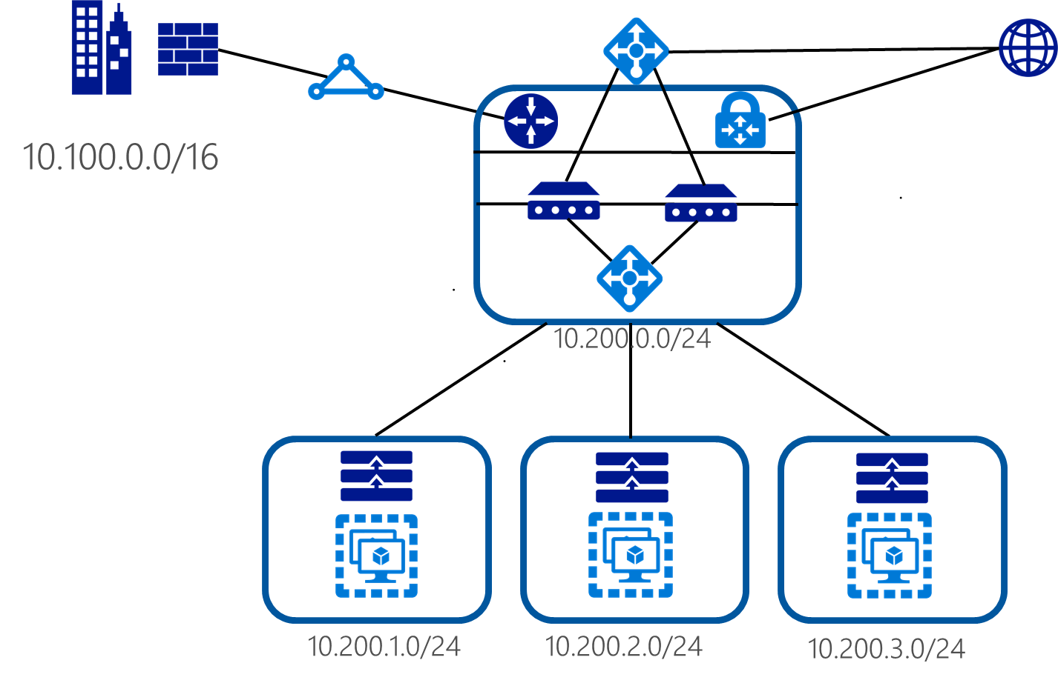
Network Topology & Connectivity
Azure Region = 10.200.0.0/16
IP Addressing
Design Recommendation
Notes:
1 - IP Addressing
The image shows an on prem network at 10.100.0.0/16 with an azure region assigned 10.200.0.0/16 and the hub and spokes carved out as /24s.
Tip: One customer assigned 10.8.0.0/16 for azure use, but didn’t split it out by region, so 10.8.1.0 was US East and 10.8.2.0 was UK North, etc. This caused a lot of routing headaches, so be sure to plan by region.
Plan for non-overlapping IP address spaces across Azure regions and on-premises locations well in advance.
Use IP addresses from the address allocation for private internets (RFC 1918).
For environments with limited private IP addresses (RFC 1918) availability, consider using IPv6.
Do not create unnecessarily large VNets (for example: /16) to ensure that IP address space isn't wasted.
Do not create VNets without planning the required address space in advance, since adding address space will cause an outage once a VNet is connected via virtual network peering.
Do not use public IP addresses for VNets, even if a range of public IP addresses belong to your company, there are other methods for using pre-owned Public IPs in Azure.

Slide 63
Network Topology & Connectivity
Azure ExpressRoute and Azure VPN (S2S) have different capabilities, costs and performance, a table is available for comparison
When multiple virtual networks are connected to the same ExpressRoute circuit, they'll become part of the same routing domain, and all virtual networks will share the bandwidth.
Connectivity to Azure
Design Considerations
Notes:
KEY POINTS:

Slide 64
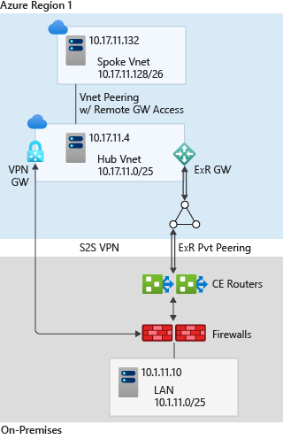
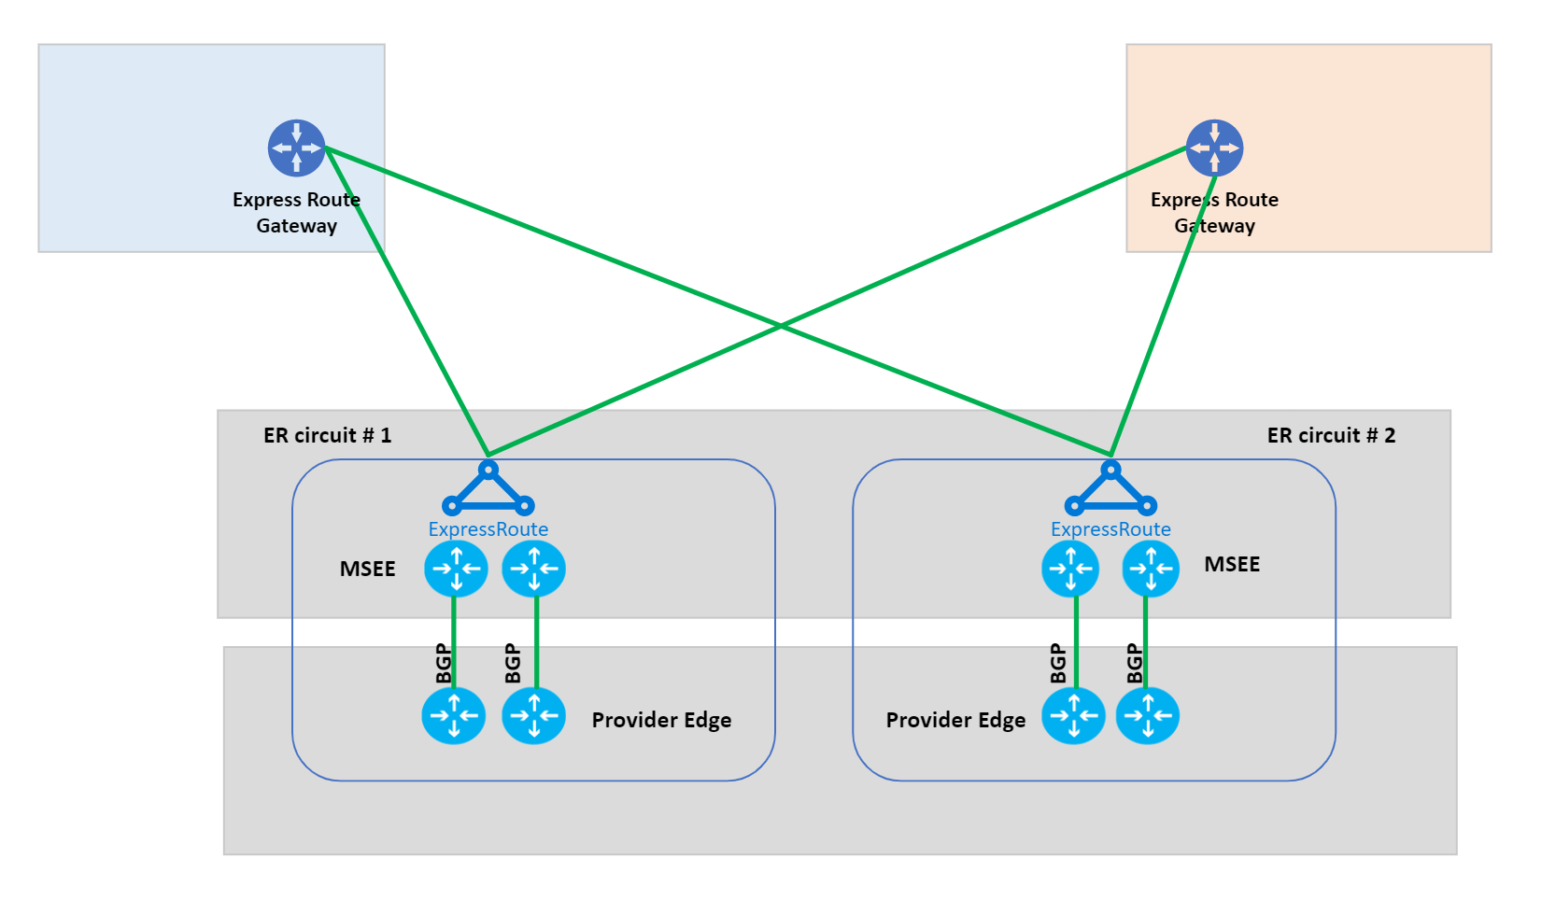
Network Topology & Connectivity
Use ExpressRoute as the primary connectivity channel for connecting an on-premises network to Azure. You can use VPNs as a source of backup connectivity to enhance connectivity resiliency
Use dual ExpressRoute circuits from different peering locations when you're connecting an on-premises location to virtual networks in Azure to prevent single points of failure.
Connectivity to Azure
Design Recommendation
Notes:
4 – Connectivity – To Azure
Use ExpressRoute as the primary connectivity channel for connecting on-premises network to Microsoft Azure. VPNs can be used as a source of backup connectivity to enhance connectivity resiliency.
Use dual ExpressRoute circuits from different peering locations when connecting an on-premises location to VNets in Azure. This setup will ensure redundant paths to Azure, removing single points of failure between on-premises and Azure.
When multiple ExpressRoute circuits are used, optimize ExpressRoute routing via BGP local preference and AS PATH prepending.
Ensure the right SKU is used for the ExpressRoute/VPN gateways based on bandwidth and performance requirements.
Deploy a zone redundant ExpressRoute gateway in the supported Azure regions.
For scenarios that require bandwidth higher than 10 Gbps or dedicated 10/100 Gbps ports, use ExpressRoute Direct.
When low latency is required, or throughput from on-premises to Azure must be greater than 10 Gbps, enable FastPath to bypass the ExpressRoute gateway from the data path. For now, only the HUB supports FastPath, Spoke Vnets will support that by the end of CY2021.
Use VPN gateways to connect branches or remote locations to Azure. For higher resilience, deploy zone-redundant gateways (where available).
Use ExpressRoute Global Reach to connect large offices/regional headquarters/datacenters connected to Azure via ExpressRoute.
When traffic isolation or dedicated bandwidth is required (such as for separating production and nonproduction environments), different ExpressRoute circuits should be used to ensure isolated routing domains and to alleviate noisy-neighbor risks.
Proactively monitor ExpressRoute circuits using Azure Network Performance Monitor.
Do not explicitly use ExpressRoute circuits from a single peering location only, as this creates a single point of failure and makes the customer susceptible to peering location outages.
Do not use the same ExpressRoute circuit to connect multiple environments that require isolation or dedicated bandwidth to avoid noisy-neighbor risks.

Slide 65
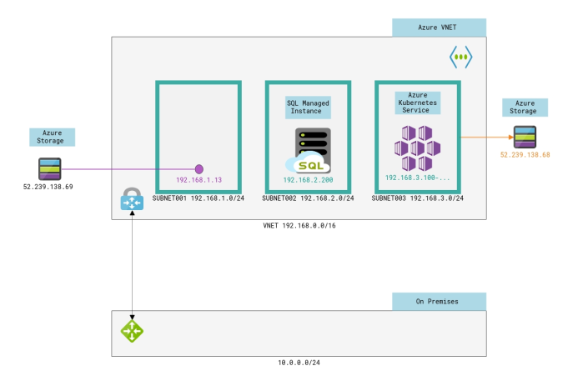
Network Topology & Connectivity
Azure PaaS services are typically accessed over public endpoints. However, the Azure platform provides capabilities to secure such endpoints or even make them entirely private:
Virtual network injection provides dedicated private deployments for supported services
Azure Private Link provides dedicated access by using private IP addresses to Azure PaaS instances. Prevents data exfiltration concerns as well
Virtual network service endpoints provide service-level access from selected subnets to selected PaaS services.
Connectivity to PaaS services
Design Considerations
Notes:
KEY POINTS:

Slide 66
Network Topology & Connectivity
Use Private Link, where available, for shared Azure PaaS services. You can use private link cross-tenant as well.
Access Azure PaaS services from on-premises via ExpressRoute with private peering
Use virtual network service endpoints to secure access to Azure PaaS services from within your virtual network, but only when Private Link isn't available and there are no data exfiltration concerns
Don't enable virtual network service endpoints by default on all subnets.
Connectivity to PaaS services
Design Recommendation
Notes:
The nuance difference between “VNET injection” and “Private Link” is that the first is used for resources dedicated to you (AKS Workers, SQL Managed Instance, …) and the latter is used for services that share resources underneath (AKS Master Nodes, Azure SQL DB, Azure Storage, …)

Slide 67
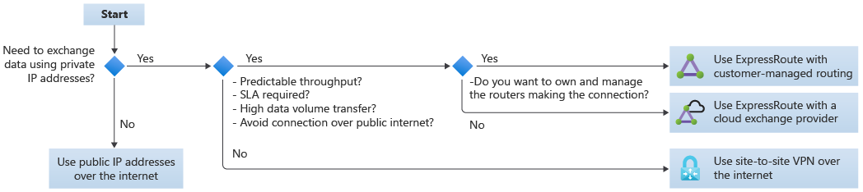
Network Topology & Connectivity
Options available:
Routing complexity of Azure ExpressRoute and other cloud provider equivalent with customer-managed routing can be high if not done through a cloud exchange provider.
You might need to provide DNS resolution between Azure and the other cloud provider
Be careful for not overlapping IP addresses
Connectivity to other cloud providers
Design Recommendation
Notes:
The nuance difference between “VNET injection” and “Private Link” is that the first is used for resources dedicated to you (AKS Workers, SQL Managed Instance, …) and the latter is used for services that share resources underneath (AKS Master Nodes, Azure SQL DB, Azure Storage, …)

Slide 68
Network Topology & Connectivity
Azure Load Balancer (internal and public) provides high availability for application delivery at a regional level.
Azure Application Gateway allows the secure delivery of HTTP/S applications at a regional level.
Azure Front Door allows the secure delivery of highly available HTTP/S applications across Azure regions.
Azure Traffic Manager allows the delivery of global applications.
Application Delivery
Design Considerations
Notes:
KEY POINTS:

Slide 69
Network Topology & Connectivity
For secure delivery of HTTP/S applications, use Application Gateway v2 and ensure that WAF protection and policies are enabled. As an alternative, use a 3rd party NVA. If application is deployed cross-region use Azure Front Door
Use a DDoS standard protection plan for all public IP addresses in a landing zone.
Use Traffic Manager to deliver global applications that span protocols other than HTTP/S.
Application Delivery
Design Recommendation
Notes:
The nuance difference between “VNET injection” and “Private Link” is that the first is used for resources dedicated to you (AKS Workers, SQL Managed Instance, …) and the latter is used for services that share resources underneath (AKS Master Nodes, Azure SQL DB, Azure Storage, …)

Slide 70
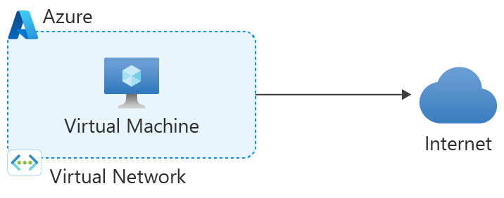
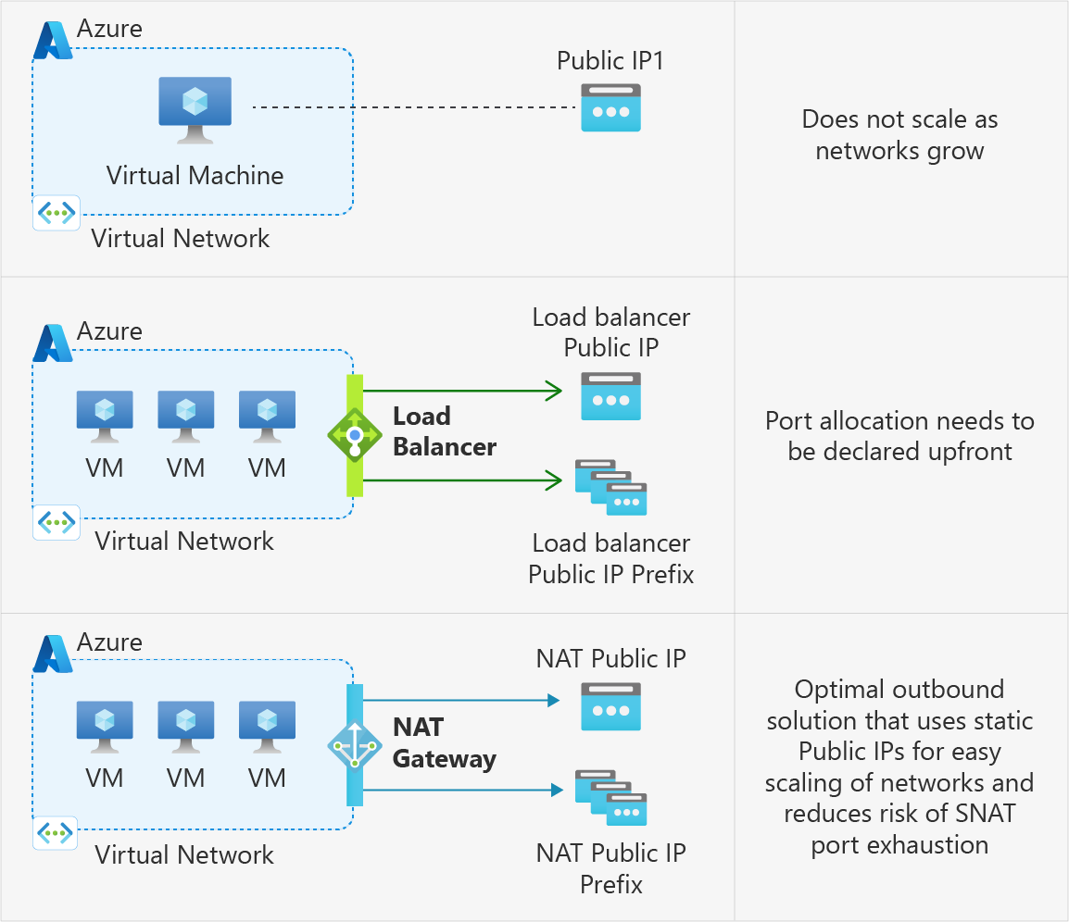
Network Topology & Connectivity
Internet Connectivity
Design Considerations
Notes:
KEY POINTS:

Slide 71
Network Topology & Connectivity
Don't replicate on-premises perimeter network concepts and architectures into Azure
Use Azure Firewall/3rd party NVA to govern:
Azure outbound traffic to the internet.
Non-HTTP/S inbound connections
East/west traffic filtering (if your organization requires it)
Use Azure Firewall premium if advanced firewall capabilities are required (TLS inspection, network intrusion detection and prevention system (IDPS), URL filtering, web categories)
Use Azure Application Gateway/3rd party NVA for inbound HTTP/S traffic
Do not expose virtual machine management ports to internet
Use Azure Policy to prevent virtual machines creation with public IP attached.
Use Azure Bastion to access jump-boxes virtual machines for management purposes
Internet Connectivity
Design Recommendation
Notes:
4 – Connectivity – Internet:
Use Azure Firewall to govern:
Azure outbound traffic to the internet
Non-HTTP/S inbound connections
East-west traffic filtering (if required by the customer)
Use Firewall Manager with Virtual WAN to deploy and manage Azure firewalls across Virtual WAN hubs or in hub VNets.
Create a global Azure Firewall policy to govern security posture across the global network environment and assign it to all Azure Firewall instances. Allow for granular policies to meet requirements of specific regions by delegating incremental firewall policies to local security teams via RBAC.
Configure supported third-party SaaS security providers within Firewall Manager if your wish to use such solutions to protect outbound connections.
Use WAF within a landing zone VNet for protecting inbound HTTP/S traffic from the internet.
Use Azure Front Door and WAF policies to provide global protection across Azure regions for inbound HTTP/S connections to a landing zone.
When using Azure Front Door and Azure Application Gateway to protect HTTP/S apps, use WAF policies in Azure Front Door and lock down Azure Application Gateway to receive traffic only from Azure Front Door.
If third-party NVAs are required for east-west and/or south-north traffic protection/filtering:
For Virtual WAN network topologies, deploy the NVAs to a separate VNet (for example, NVA VNet), and connect it to the regional Virtual WAN hub and to the landing zones that require access to NVAs, as described in this article.
For Traditional Vnet topologies, deploy the third-party NVAs in the central hub VNet.
If third-party NVAs are required for inbound HTTP/S connections, they should be deployed within a landing zone VNet and together with the apps that they're protecting and exposing to the internet.
Use Azure DDoS Protection Standard protection plans to protect all public endpoints hosted within your VNets.
Do not replicate on-premises DMZ concepts and architectures into Azure, as customers can get similar security capabilities in Azure as with on-premises, but the implementation and architecture will need to be adapted to the cloud.

Slide 72
Network Topology & Connectivity
The zero-trust model assumes a breached state and verifies each request as though it originates from an uncontrolled network
Subnets and Network Security Groups (NSG) and the main responsible for network segmentation
Segmentation
Design Considerations
Notes:
KEY POINTS:

Slide 73
Network Topology & Connectivity
Delegate subnet creation to the landing zone owner.
Single large subnet vs multitier application vs network-injected application
The platform team can use Azure Policy to ensure that an NSG with specific rules is always associated with subnets that have deny-only policies.
Use NSGs to help protect traffic across subnets, as well as east/west traffic across the platform
Use NSGs and application security groups to micro-segment traffic within the landing zone and avoid using a central NVA to filter traffic flows.
Enable NSG flow logs and feed them into Traffic Analytics to gain insights into internal and external traffic flows
Segmentation
Design Recommendation
Notes:
4 – Connectivity – Network Segmentation
So one more time, Delegate subnet creation to the landing zone owner. This will enable them to define how to segment workloads across subnets (for example, a single large subnet, multitier app, or VNet-injected app). The platform team can use Azure Policy to ensure an NSG with specific rules (such as deny inbound SSH or RDP from internet, or allow/block traffic across landing zones) is always associated to subnets with deny-only policies.
NSGs must be used to protect traffic across subnets, as well as east-west traffic across the platform (inter-landing-zone traffic).
The app team should use application security groups at the subnet level NSGs to protect multi-tier VMs within their landing zone.
Use NSGs and application security groups to micro-segment traffic within the landing zone and avoid using a central NVA to filter traffic flows.
Enable NSG flow logs v2 and feed them into Traffic Analytics to gain insights into internal and external traffic flows.
Use NSGs to selectively whitelist inter-landing-zone connectivity.
For Virtual WAN topologies, route traffic across landing zones via Azure Firewall if the customer requires filtering and logging capabilities for traffic flowing across landing zones.
Tip: NSGs can be used to implement zero trust principles but keep in mind they don’t inspect traffic (I.E. if the NSG is allow 443 and a bad actor tunnels ssh through 443, the nsg will allow it where a NGFW would block it).

Slide 74
Network Topology & Connectivity
When you're using ExpressRoute with private peering, traffic isn't currently encrypted
Its is possible to configure a Site-to-Site VPN connection over ExpressRoute private peering
You can apply media access control security (MACsec) encryption to ExpressRoute Direct to achieve network encryption
When Azure traffic moves between datacenters (outside physical boundaries not controlled by Microsoft or on behalf of Microsoft), MACsec data-link layer encryption is used on the underlying network hardware. This is applicable to VNet peering traffic.
Network Encryption
Design Considerations
Notes:
KEY POINTS:

Slide 75
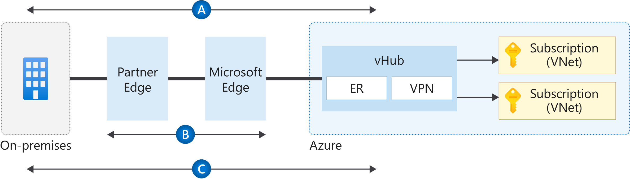
Network Topology & Connectivity
Choose an encryption option depending on your requirements:
Network Encryption
Design Recommendation
Notes:
4 – Connectivity – Encryption Options
When establishing VPN connections from on-premises to Azure using VPN gateways, traffic is encrypted at a protocol level using IPsec tunnels, as described in Flow A in the diagram.
When using ExpressRoute Direct, configure media access control security (MACsec) in order to encrypt traffic at the layer-two level between the customer's routers and MSEE, as described in Flow B.
For Virtual WAN scenarios where MACsec isn't an option (for example, not using ExpressRoute Direct), use VPN gateway to establish IPsec tunnels over ExpressRoute private peering. This is depicted by Flow C.
For scenarios where MACsec isn't an option (for example, not using ExpressRoute Direct), today the only options is to use third-party NVAs or VPN GW to establish IPsec tunnels over ExpressRoute private peering or establish a VPN tunnel over ExpressRoute with Microsoft peering as well. VPN GW over Private I believe it is in Preview.
If traffic between Azure regions must be encrypted, use VPN gateways to connect VNets across regions.
Use third-party NVAs in Azure to encrypt traffic over ExpressRoute private peering in case native solutions offered in Azure (as described in flows B and C) do not meet your requirements.
Tip: Ipsec can also be used on individual VMs to encrypt traffic. Also, many customers falsely assume every bit of traffic in any public cloud is encrypted by default (like storage is).
Traffic Inspection –
Azure Virtual Network TAP (VTAP) is in preview, but you can reach to azurevnettap@microsoft.com for availability details.
Network Watcher packet captures in Network Watcher is GA, but captures are limited to a maximum period of 5 hours.
Use Network Watcher packet capture despite the limited capture window.
Evaluate if NSG Flow Logs v2 provide the level of detail required.
Use 3rd party solutions for scenarios where sustained deep packet inspection is required.
Do not develop a custom solution to mirror traffic. While this might be acceptable for small scale scenarios, this approach is not encouraged at scale due to complexity and supportability issues which may arise.
Tip: Any enterprise with a requirement for ‘deep packet inspection’ is going to use a 3rd party NVA until azfw supports it (NDA roadmap).

Slide 76
Network Topology & Connectivity
You can use a DNS resolver in conjunction with Azure Private DNS for cross-premises name resolution. Azure DNS Private Resolver is available as well in public preview
You might require the use of existing DNS solutions across on-premises and Azure.
The maximum number of private DNS zones to which a virtual network can link with auto-registration is one.
Familiarize yourself with Azure Private DNS zone limits.
DNS
Design Considerations
Notes:
KEY POINTS:

Slide 77
Network Topology & Connectivity
For environments where name resolution in Azure is all that's required:
Use Azure Private DNS zones for resolution
Create a delegated zone for name resolution (such as azure.contoso.com)
Enable auto-registration for Azure Private DNS to automatically manage the lifecycle of the DNS records for the virtual machines deployed within a virtual network
For environments where name resolution across Azure and on-premises is required:
Use existing DNS infrastructure (for example, Active Directory integrated DNS) deployed onto at least two virtual machines (VMs). Configure DNS settings in virtual networks to use those DNS server
or
Azure DNS Private Resolver (public preview)
DNS
Design Recommendation
Notes:
2 - DNS Configuration
Key take away is that you must have some sort of resolver in Azure to resolve especially private link names, period!
DNS on prem only will lead to resiliency issues as many applications will be dependent on name resolution, be careful using this design option, and remember this is not recommended.
Nginx DNS proxy: https://github.com/microsoft/PL-DNS-Proxy
Tip – A common scenario here is when a customer extends their DNS infra to Azure (Infoblox, AD, etc) but also uses the azure DNS resolver 168.* address as a forwarder for those in-azure DNS servers to assure private link resolution.
Design recommendations:
For environments where name resolution in Azure is all that's required, use Azure Private DNS for resolution by creating a delegated zone for name resolution (such as azure.contoso.com).
For environments where name resolution across Azure and on-premises is required, use existing DNS infrastructure (for example, Active Directory integrated DNS) deployed onto at least two Azure VMs and configure DNS settings in VNets to use those DNS servers.
Azure Private DNS can still be used where the Azure Private DNS zone is linked to the VNets and DNS servers are used as hybrid resolvers with conditional forwarding to on-premises DNS names (such as onprem.contoso.com) using on-premises DNS servers. On-premises servers can be configured with conditional forwarders to resolver VMs in Azure for the Azure Private DNS zone (for example, azure.contoso.com).
Special workloads that require and deploy their own DNS (such as Red Hat OpenShift) should use their preferred DNS solution.
Auto-registration should be enabled for Azure DNS to automatically manage the lifecycle of the DNS records for the virtual machines deployed within a VNet. But be careful, because if you have multiple Azure Private DNS Zones linked to the same Vnet, only one can have the Auto-registration enabled.
Use a virtual machine as a resolver for cross-premises DNS resolution with Azure Private DNS.
Create the Azure Private DNS zone within a global connectivity subscription. Additional Azure Private DNS zones might be created (for example, privatelink.database.windows.net or privatelink.blob.core.windows.net for Azure Private Link).

Slide 78
Network Topology & Connectivity
Questions?
Notes:
4 – Connectivity – Encryption Options
When establishing VPN connections from on-premises to Azure using VPN gateways, traffic is encrypted at a protocol level using IPsec tunnels, as described in Flow A in the diagram.
When using ExpressRoute Direct, configure media access control security (MACsec) in order to encrypt traffic at the layer-two level between the customer's routers and MSEE, as described in Flow B.
For Virtual WAN scenarios where MACsec isn't an option (for example, not using ExpressRoute Direct), use VPN gateway to establish IPsec tunnels over ExpressRoute private peering. This is depicted by Flow C.
For scenarios where MACsec isn't an option (for example, not using ExpressRoute Direct), today the only options is to use third-party NVAs or VPN GW to establish IPsec tunnels over ExpressRoute private peering or establish a VPN tunnel over ExpressRoute with Microsoft peering as well. VPN GW over Private I believe it is in Preview.
If traffic between Azure regions must be encrypted, use VPN gateways to connect VNets across regions.
Use third-party NVAs in Azure to encrypt traffic over ExpressRoute private peering in case native solutions offered in Azure (as described in flows B and C) do not meet your requirements.
Tip: Ipsec can also be used on individual VMs to encrypt traffic. Also, many customers falsely assume every bit of traffic in any public cloud is encrypted by default (like storage is).
Traffic Inspection –
Azure Virtual Network TAP (VTAP) is in preview, but you can reach to azurevnettap@microsoft.com for availability details.
Network Watcher packet captures in Network Watcher is GA, but captures are limited to a maximum period of 5 hours.
Use Network Watcher packet capture despite the limited capture window.
Evaluate if NSG Flow Logs v2 provide the level of detail required.
Use 3rd party solutions for scenarios where sustained deep packet inspection is required.
Do not develop a custom solution to mirror traffic. While this might be acceptable for small scale scenarios, this approach is not encouraged at scale due to complexity and supportability issues which may arise.
Tip: Any enterprise with a requirement for ‘deep packet inspection’ is going to use a 3rd party NVA until azfw supports it (NDA roadmap).

Slide 79
Critical design areas
Enterprise Enrolment and Azure AD Tenants
Identity and Access Management
Management Group and Subscription Organisation
Network Topology and Connectivity
Management and Monitoring
Business Continuity and Disaster Recovery
Security, Governance, and Compliance
Platform Automation and DevOps
Notes:
Out of scope: This exercise focuses on the foundation for a modern security operations center in the cloud. To streamline the conversation, this exercise doesn't address some of the disciplines in the CAF Secure methodology. Security operations, asset protection, and innovation security will build on your Azure landing zone deployment. However, they're out of scope for this design area discussion.

Slide 80
Technology
Defense in depth
Identity & access | Security management | Threat protection | Apps security | Data security | Network security
Role based access | Cloud security posture management | SIEM | Dependency management | Encryption | DDoS protection
Multi-factor authentication | Policy and governance | Extended Detection and Response (XDR) | Code security | Confidential computing | Firewall
Central identity management | Regulatory compliance | External Attack Surface Management (EASM) | Key management | Auditing | Web app firewall
Identity protection | Unified security management | VM & cloud native asset protection | Certificate management | Data masking & erasure | Private connections
Privileged identity management | Hybrid and multi-cloud | Antimalware |  | Information protection & governance | NetSec policy management
 |  | IoT Security
Microsoft + Partners
Notes:
Azure offers a defense-in-depth approach to security, across all pillars of your environment. We offer security solutions, controls, and services across identity, security management, threat protection, application security, data security, and network security.

Slide 81
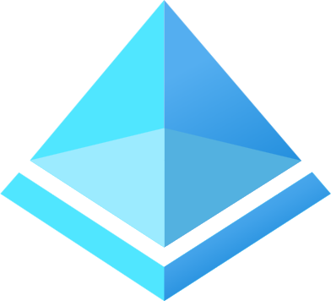


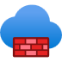












Azure security technology and services
Protect Azure and your entire multi-cloud environment with built-in security, powered by AI
Identity and access management
Threat protection
Apps & data security
Network security
Azure Active Directory
Your universal platform to manage and secure all your users and data
Microsoft Sentinel
Intelligent security analytics for your entire enterprise
Azure confidential computing
Protect your data and code while in use in the cloud
Azure Firewall
Cloud-native firewall to protect Azure virtual networks
RiskIQ EASM
Discover and monitor for your global attack surface
Azure Key Vault
Safeguard cryptographic keys and other secrets
Azure Firewall Manager
Central network security policy management
RiskIQ threat intelligence
Adversary-threat insights relevant to your external attack surface
Azure attestation
Store and process confidential data with confidence
Azure Web Application Firewall
Protect web/mobile apps and APIs from common web vulnerabilities
Security posture management
Microsoft Defender for Cloud
Security posture management for your multicloud environments
Microsoft Defender for Cloud
Built-in threat protection for multicloud and hybrid workloads
Azure dedicated HSM
Your hardware security module (HSM) in the cloud
Azure Front Door
Fast, reliable and secure cloud CDN with threat protection
Microsoft Defender for IoT
Agentless asset discovery, vulnerability management, and threat detection for IoT/OT devices
GitHub
Build secure apps rights from the start
Azure DDoS protection
Always-on monitoring to protect against DDoS attacks
Azure Bastion
Private and fully managed RDP and SSH access to your VMs

Slide 82
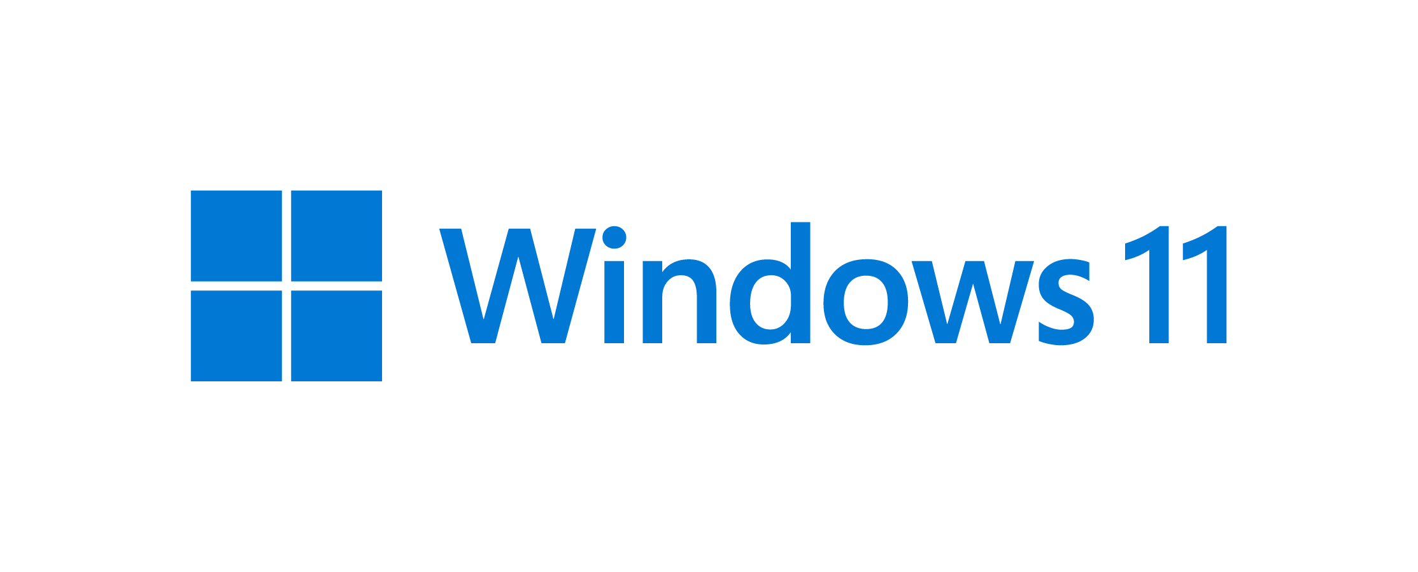


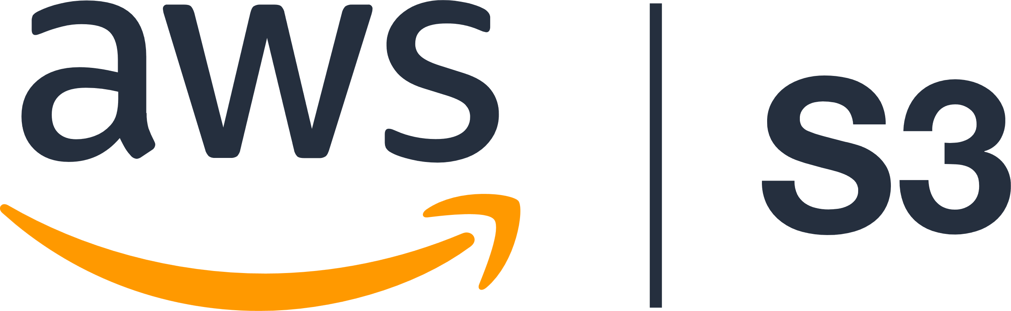

Stay ahead of attackers with a unified SecOps experience
SIEM
Microsoft Sentinel
Cloud native, any data, any entity
Microsoft 365 Defender
Microsoft Defender for Cloud
Secure your end user environment
Secure your infrastructure
XDR
Notes:
Our approach to your security is to understand both the breadth and depth of your entire estate, and look at everything going, end-to-end.
Our breadth approach is delivered with Microsoft Sentinel, our cloud native SIEM (security information event management tool). A SIEM is a tool that aggregate logs from all a company's sources (OS, application, antivirus, database, or server logs) and analyzes large quantities of data from one place, searching for anomalies and signs of a threat.
The depth is delivered through Microsoft Defender, our extended detection and response (or XDR).
XDR is an emerging technology in threat protection that helps address the need for security operations teams to increase efficiency and effectiveness to get ahead of today’s threats.
Endless list of alerts from a multitude of security point products make it difficult for defenders to link those effectively and at speed to contain a threat. XDR delivers an intelligent, automated, integrated security to close gaps in prevention, detection, and response.
Microsoft offers the most comprehensive XDR available on the market today with Microsoft Defender.
As well as taking a breadth and depth approach to your security, we apply Microsoft’s incredible breadth of data, over a trillion signals, to these products to gain faster insights with greater accuracy using machine learning.
And we tap into the knowledge of thousands of world class Microsoft researchers to understand new macro trends across the landscape, as well as unique attacks and anomalies.
This insight from our data and our researchers helps your Security Teams by
-Protecting: and staying on top of any new attacks in an efficient way.
-And Preventing. Staying on top of the endless to-do list to make attacks useless to begin with.
Let's take a closer look at Azure Sentinel and Microsoft Defender.

Slide 83

Gain insights across your entire enterprise
SIEM
Microsoft Sentinel
Multi-cloud
Partnerships
First cloud-native SIEM on a major cloud platform, with over 9,000 customers
Cloud native, any data, any entity
Collect security data at cloud scale and integrate with your existing tools
Leverage AI to detect emergent threats, reducing false positives by 79% over three years¹
Respond rapidly with built-in orchestration and automation
TI
AI
Visibility
Automation
Attack surface intelligence
1: Commissioned study-The Total Economic Impact™ of Microsoft Azure Sentinel, conducted by Forrester Consulting, 2020
Notes:
Everything comes together with Microsoft Sentinel, a new cloud-native solution that re-imagines the SIEM + SOAR tool. Microsoft Sentinel provides intelligent security analytics at cloud scale for your entire enterprise.
Microsoft Sentinel makes it easy to collect security data across your entire hybrid organization—from devices, users, apps, servers, and any cloud. Sentinel uses the power of AI to help you quickly identify real threats and releases you from the burden of traditional SIEMs by eliminating the need to spend time on setting up, maintaining, and scaling infrastructure. Since it’s built on Azure, Sentinel offers limitless cloud scale and speed, and scales automatically to address your needs.
SecOps can focus on quickly finding real threats. Microsoft Sentinel helps reduce noise from legitimate events with built-in machine learning and knowledge based on the analysis of trillions of signals daily. In February 2020, we shared an example of how Azure Sentinel used machine learning with its fusion capabilities and filtered through 50B+ anomalous alerts and reduced it to 25 high-fidelity actionable incidents. This example shows how Sentinel can help reduce alert fatigue by 90 percent.¹
Threat hunters can be more proactive with pre-built queries shared by Microsoft security experts. The built-in user and entity behavior analytics help to identify anomalies and extract behavioral insights for threat hunting and detection. With a rich, interactive investigation experience, SecOps can view a prioritized list of alerts, get correlated analysis of thousands of security events within seconds, and visualize the entire scope of every attack.
You can simplify security operations and speed up threat response with integrated automation and orchestration of common tasks and workflows. The integration with hundreds of solutions through Azure Logic Apps enables you to use the built-in playbooks or customize your own, to automate your response.
Traditional SIEMs are expensive to own and operate, and often require up-front commitments while incurring high costs for infrastructure maintenance and data ingestion. Sentinel has no up-front costs, and you pay for what you use. Additionally, you can ingest data from Microsoft 365 audit logs, Azure activity logs, and alerts from Microsoft threat-protection solutions at no additional cost.² On top of that, from November 1, 2020 through May 1, 2021, Microsoft 365 E5 and Microsoft 365 E5 Security customers can get Azure credits totaling up to 100MB per user/month of Microsoft 365 data ingestion into Sentinel. With these credits, a standard 3,500 seat deployment can see estimated savings of up to $1,500 per month.³ This offer is available to new and existing customers who have Enterprise (EA) or Enterprise Subscription (EAS) Agreements and Enrollments. There is no nomination process, and you can automatically begin accruing credits in your first month of eligibility.
1 https://www.microsoft.com/security/blog/2020/02/20/azure-sentinel-uncovers-real-threats-hidden-billions-low-fidelity-signals/
2 https://azure.microsoft.com/en-us/pricing/details/security-center/
3 Calculation based on pay-as-you-go prices for Azure Sentinel and Azure Monitor Log Analytics for US East region.
Link to promo: https://azure.microsoft.com/en-us/free/

Slide 84

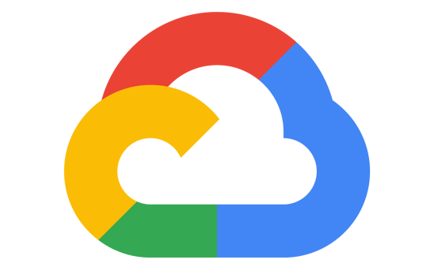
Protect cloud and hybrid workloads from threats
Reduce time to threat mitigation by 50 percent
Protect data services, cloud-native services, Windows and Linux servers, and IoT from threats
Extend protection to on-premises and multicloud for virtual machines and SQL databases using Azure Arc
With prioritized alerts, focus on what matters the most
SQL/Storage
Server VMs
Containers
Network traffic
Apps
Microsoft Defender for Cloud
Multicloud
Microsoft Azure
Amazon Web Services
Google Cloud
Source: Forrester Consulting, “The Total Economic Impact™ of Microsoft Azure Security Center, Cost Savings and Business Benefits Enabled By Azure Security Center,” February 2021, commissioned by Microsoft.
Notes:
Microsoft Defender for Cloud provides a cloud-native extended detection and response (XDR) solution for Windows and Linux servers, containers, and serverless workloads, helping protect critical cloud workloads from new and emerging threats.
A recent “Total Economic Impact” study by Forrester Consulting found that organizations that used Defender for Cloud were able to reduce the time to threat mitigation by 50 percent. Let’s take a look at how that’s possible through the XDR capabilities of Azure Defender.
Defender for Cloud protects all your hybrid cloud workloads from data services, cloud-native services, servers, and IoT.
Integration with Microsoft Defender for Endpoints also provides preventive protection, post-breach detection, automated investigation, and response for Windows servers. You can also enable preventive protection and post-breach detection for Linux servers as well.
With Defender for SQL, you can monitor and remediate potential vulnerabilities for databases and storage services in Azure, on-premises, or in other clouds.
Built-in behavioral analytics and machine learning helps you identify attacks and zero-day exploits. Prioritized security alerts help you focus on the most critical threats first. Also, you can map different types of alerts into a single attack campaign.
Azure Defender for IoT provides continuous IoT/OT asset discovery, vulnerability management, and threat monitoring in an agentless way.
Source: Source: Forrester Consulting, “The Total Economic Impact of Microsoft Azure Security Center,” February 2021, commissioned by Microsoft.
Next Slide

Slide 85




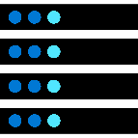



Azure confidential computing (ACC)
Protect data in use for added security and to enable secure multi-party computation
Existing encryption
ACC
“
To meet the security and privacy expectations of millions of people every day, we utilize Azure confidential computing to provide scalable, secure environments for our services. Signal puts users first, and Azure helps us stay at the forefront of data protection with confidential computing.
Data at rest
Data in transit
Data in use
”
Protect against
Jim O'Leary VP of Engineering
Malicious
privileged admins or insiders
Hackers
exploiting bugs in the Hypervisor/OS
Third parties
accessing data without customer consent
Notes:
Today we have existing solutions to encrypt data in at rest, such as encrypting through Bitlocker when saved to storage on disk. We also have standards for encryption in transit with TLS, so data passing over the network is secure. We saw this as a big transition over starting about 10 years ago with website traffic moving from HTTP to HTTPS. A gap has been protecting data while in use, and this is where confidential computing provides a solution. Now data can be processed in hardware that protects your code and data above and beyond security measures in place today. To give some detail, when your app is running in the cloud, there is trust in various components and ultimately the people that have access to these components, such as admins or even people with physical access. This leaves door open for malicious insiders to snoop in on the data while its processing. ACC can help you protect against malicious insiders or hackers who can get access to your code while it is running. You are also protected against admin credentials getting phished <click>
With this confidential computing technology, new opportunities are possible, where regulated industries such as financial services or healthcare can now leverage the public cloud for scalable data analysis. Even more, organizations can combine data in the cloud for share analytics, without giving access to the sensitive data to the cloud provider or each participant. In this example, you can see multiple hospitals sending patient data to Azure to create a larger dataset for machine learning analysis to result in improved outcomes for disease diagnosis. The same can apply in other industries, such as fraud detection in banking.
And this is only the beginning. With Azure confidential computing, we aim to shift from the Azure cloud to the Azure confidential cloud.

Slide 86


Build secure apps from the start
Implement integrated DevSecOps for secure development and deployment of applications
Deploy secure code across clouds–Azure, AWS, Google Cloud, and others
Helps reduce security effort, increase development speed, and improve application security
Focus on actionable and high priority security issues within the developer workflow
Have peace of mind with enforced security and compliance policies
Provide central visibility to security admins through Microsoft Defender for Cloud integration
Supply chain
Code
Development lifecycle
Shift-left with secure DevOps
Notes:
A comprehensive approach to DevOps is critical to the fast and reliable delivery of applications to your environment. At the same time, it’s critical you ensure the security of your applications, and that you integrate that security into the entire application development, deployment, and maintenance lifecycle. Securing your code is just as important as securing your cloud resources and SaaS apps. Consider the following:
94% of projects use open source¹
85% of codebases have components that are >4 years old²
83% of vulnerabilities are caused by dev errors¹
GitHub and Azure have all the tools you need to quickly build a secure application. Identify potential threats before you deploy your application into production using the Microsoft threat-modeling tool. Perform static and dynamic code analysis to find vulnerabilities in your code using Semmle, which GitHub recently acquired. Additionally, examine the dependencies your application has on open-source libraries or components and check for security risks using Dependentabot. Make sure you haven’t embedded your secrets such as connection strings and keys into your code, but store them securely in repositories backed by hardware security modules. You can do that using CredScan and Azure Key Vault. These tools are all integrated into your existing DevOps environment, whether they come from Microsoft or the open-source ecosystem.
It’s also important to protect all of your stack layers, such as on a standard three-tiered app, by protecting user identities and supporting multi-factor authentication. Use firewalls such as the Azure WAF to protect applications with public-facing IP addresses. In Azure, to protect your data while it’s at rest and in transit, we take data encryption to the next level with protection that extends to data while it’s in use via hardware enclaves in our confidential computing family of VMs.
It takes several steps to secure your applications. To help with those tasks, Microsoft provides best-practices documentation as well as the Secure DevOps toolkit. This helps to accelerate your workflow to ensure you protect your applications.
Now let’s talk specifically about securing open-source applications. Open source is instrumental in helping you deliver innovative apps. According to the Synopsys Open-Source Security report for 2019, 99 percent of enterprise codebases with more than 1,000 files contained open-source components. Open source’s popularity, however, makes it an easier target for attacks. That’s why it’s important to make sure you improve your security posture, which is not a trivial task. The Synopsys report also found that 85 percent of codebases had components more than four years old, and 60 percent had at least one known vulnerability. That should not be the case.
GitHub can play an instrumental role in helping you secure your open-source applications. Secure your software supply chain by tracking and patching all of your dependencies and setting alerts using Dependabot and Dependency Insights. GitHub can also help integrate security into your code-to-cloud workflows by scanning for thousands of vulnerabilities and protecting against leakage of secrets. You can perform code analysis using Semmle for static and dynamic code, and leverage GitHub token scanning to protect secrets. GitHub also provides extensive resources and community-powered queries to help facilitate your application development.
GitHub offers multiple features to help you protect your open-source applications, and you can expect further investments in this space to help you develop your applications securely.
1 State of the Octoverse 2020 report
2 Synopsys Open-Source Security report, 2019

Slide 87
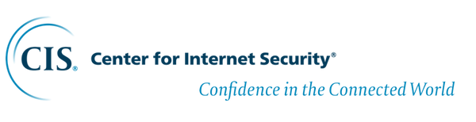

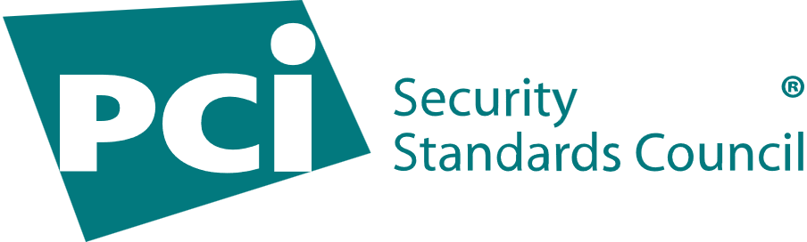
Importance of security Benchmarks
Compliance and security baselines critical for successful cloud migration
Many organizations rely on the CIS/NIST Controls security best practices to improve their cyber defenses
Compliance controls require that standard security controls are measured via configuration baselines
Security configurations that result in breaches are driving awareness to the requirements
Industry standards
NIST Special Publication 800-53
CM-2 Baseline Configuration

Slide 88

Security, Governance & Compliance
Don’t know where to start? Use Azure Security Benchmark (ASB)
The (ASB) provides prescriptive best practices and recommendations to help improve the security of workloads, data, and services on Azure
Security controls: The Azure Security Benchmark recommendations are categorized by security controls, high-level vendor-agnostic security requirements
Service recommendations: When available, benchmark recommendations for Azure services will include Azure Security Benchmark recommendations that are tailored specifically for that service.
Azure Security Benchmarks
Design Recommendation
Notes:
[Azure Security Benchmarks]
Attackers are always looking for new way to compromise systems so aligning to the Azure Security Benchmarks helps keep landing zone resources configured securely by following the Azure security proven practices
And our Customers usually have a requirement to align to a security control framework like NIST or CIS
The Azure Security Benchmark (ASB) provides prescriptive practices and recommendations to help improve the security of workloads, data, and services on Azure
In the benchmarks, the mapping to NIST and CIS is already done for the customer
There are two section to the Benchmarks
Platform Security controls: These recommendations are generally applicable across your Azure tenant and Azure services. Each recommendation identifies a list of stakeholders that are typically involved in planning, approval, or implementation of the benchmark. Along with the specific recommendations for the control
Service baselines: These apply the controls to individual Azure services to provide recommendations on that service’s security configuration.

Slide 89
Security, Governance & Compliance
Be aware of Azure Key Vault transaction limits for keys and secrets
Isolate application-specific and workload-specific secrets and shared secrets, as necessary, to control access
Optimize Premium SKUs where HSM-protected (Hardware Security Module) keys are required
Underlying HSMs are FIPS 140-2 Level 2 compliant. Manage Azure dedicated HSM for FIPS 140-2 Level 3 compliance by considering the supported scenarios
Manage key rotation and secret expiration
Set disaster recovery requirements for keys, certificates, and secrets
Monitor key, certificate, and secret usage
Set requirements for using customer-managed keys for native encryption mechanisms, such as Azure Storage encryption:
Customer-managed keys
Whole-disk encryption for virtual machines (VMs)
Data-in-transit encryption
Data-at-rest encryption
Encryption & Key Management
Design Considerations
Notes:
KEY POINTS:

Slide 90
Security, Governance & Compliance
Provision Azure Key Vault with the soft delete and purge policies enabled to allow retention protection for deleted objects
Follow a least-privilege model by limiting the authorization to permanently delete keys, secrets, and certificates to specialized custom Azure Active Directory (Azure AD) roles
Establish an automated process for key and certificate rotation
Enable firewall and virtual network private endpoints on the vault to control access to the key vault
Use the platform-central Azure Monitor Log Analytics workspace to audit key, certificate, and secret usage within each instance of Key Vault
Delegate Key Vault instantiation and privileged access, and use Azure Policy to enforce a consistent compliant configuration
Default to Microsoft-managed keys for principal encryption functionality, and use customer-managed keys when required
Don't use centralized instances of Key Vault for application keys or secrets
Encryption & Key Management
Design Recommendation
Notes:
[Encryption and Key Management]
All customers care about encryption
It is one of the most important topics when moving workloads and data into Azure
Enterprise scale leverages the built-in native capabilities for encryption at rest and in transit
And when you approach this section of the design, you need to understand these native capabilities to add additional layers of protection
Given the current threat landscape its important to keep Secrets, Keys, and Certificates protected
This is the lens we use to talk about Key Vault
Some of the guidelines are scale limits and some are for the auditing controls
But one of the key principles is to use Federated Key Vaults instead of shared key vaults
This allows a key vault to be a boundary for securing a workload and also minimizes exposure
Along with protecting secrets keys and certificates you have to also protect the key vault for disaster recovery or in the event of a breach by making sure keys are backed up and available
So go through these design considerations carefully and follow the prescriptive design recommendations when planning for encryption and key management

Slide 91
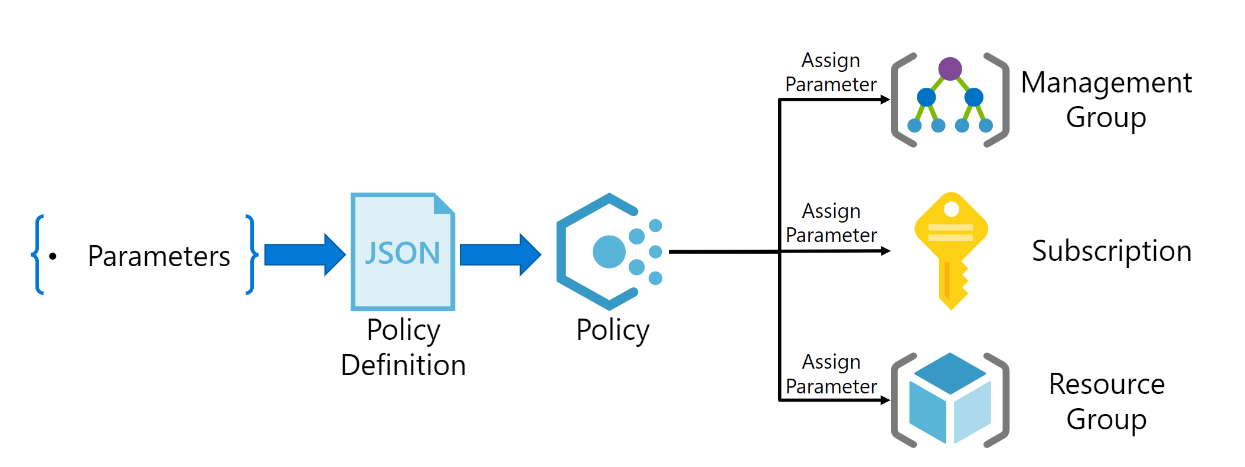
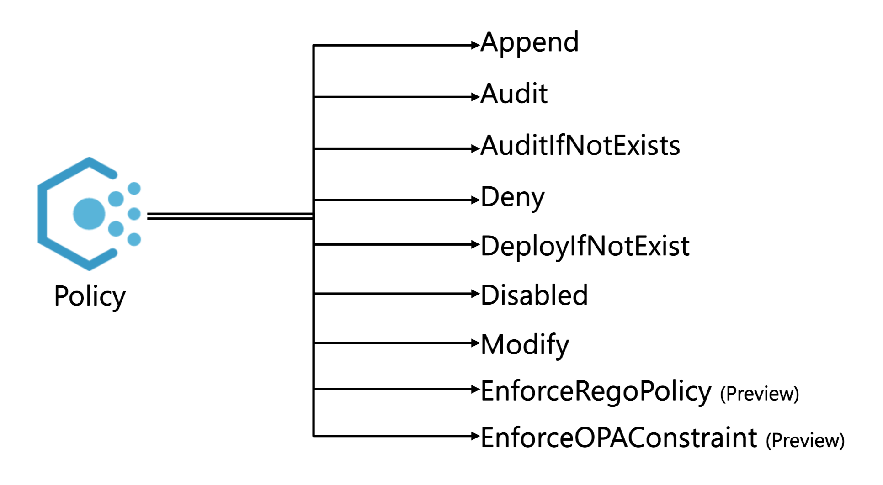
Security, Governance & Compliance
Plan for Governance & Compliance
Design Considerations
Notes:
KEY POINTS:

Slide 92
Security, Governance & Compliance
Adopt policy driven governance (‘guard rails’). Check the recommended methodology
Applied at management group level inherited by subscriptions
DeployIfNotExist to lock down security configuration at deployment
Several Policy Initiatives for wholistic policy coverage
Plan for
Governance & Compliance
Design Recommendation
Notes:
[Plan for Governance]
The most important part of planning for governance is the management group structure and where policies are applied
This allows a very consistent approach to maintaining a secure posture as well as a structured approach for RBAC assignments
Take note that policies are deployed at the highest level and leverage mostly built-in policies to simplify configuration
Exclusions will take place at lower levels and thoughtfully validated with Service enablement requirements
Also take note that the policies leverage DeployIfNotExist and Append to assure that setting are applied consistently no matter how a resource is created. One example is Key Vault Soft Delete
When a key vault is deployed into any subscription, a deployifnotexist will press down the Soft Delete to ensure key deletion is intended and recoverable
Also there are Policy Initiatives that are used for a more wholistic policy coverage of a particular service or to apply some service restriction
Some examples here are SQL and public endpoints.
For SQL there is a policy initiative that enforces TDE, Security Alert Policies, Audit Settings and Vulnerability Assessment
For Public endpoints, there is an initiative to block public endpoint of PaaS services for CosmosDB, MySQL, AKS and several others
Governance is extremely important for enterprise scale and built natively into the design leveraging a Policy driven Governance model

Slide 93
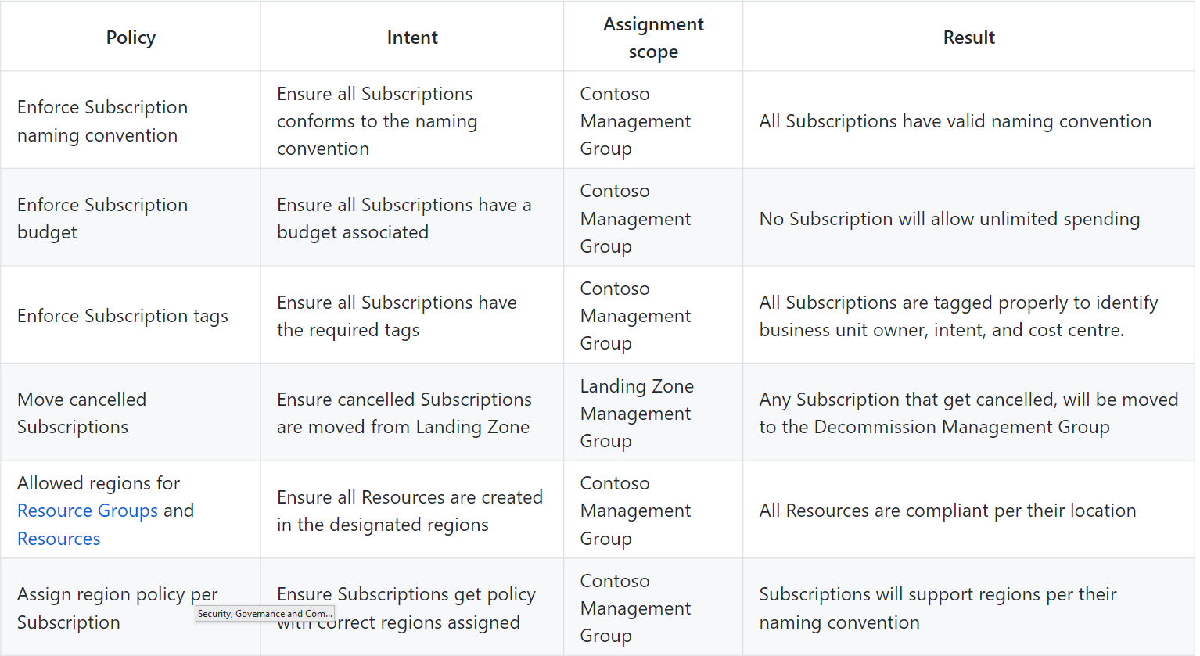

Slide 94
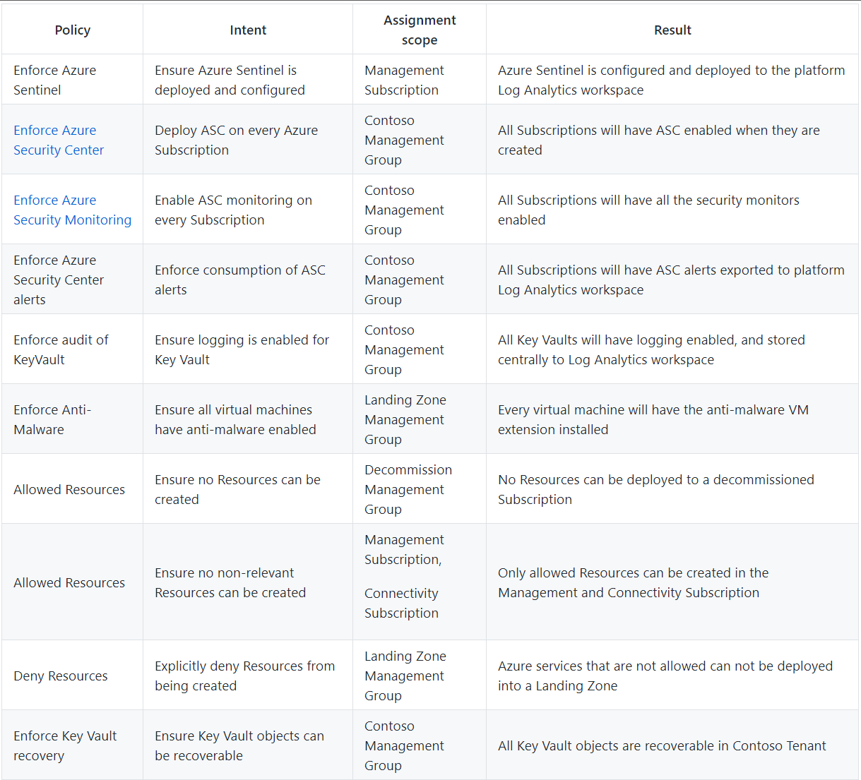

Slide 95
Security, Governance & Compliance
Use Governance and Compliance dashboard for visibility
Continuous hardening/improvement driven by Secure Score in Azure Defender for Cloud
Continuous export for archival, retention, and integration with SIEM/SOAR (Azure Sentinel or 3rd party)
Audit Key Vault access and usage
Auditing & Monitoring
Design Recommendation
Notes:
[Auditing and Monitoring]
There is a separate module for monitoring that covers it in detail but in this section we need to talk about the auditing aspects of Enterprise Scale
Is important that landing zones are audited often to ensure the governance and policies are doing their job.
Its also important to be able to keep an eye out for feature changes
One security audit I recently performed the customer did not have HTTPS enable for most of the storage accounts.
This is because this feature was added in later in its lifecycle but the customer was not evolving with the platform
This is the exact type of exposure modern attacks capitalize on the get a foothold in an organization so it important to audit the cloud estate.
To help with this Enterprise Scale turn on logging across all the subscription via policy
For additional auditing concerns, Azure Security Center can be leveraged to measure policy effectiveness with the Secure Score and in the Compliance Dashboard leveraging the Azure Security Benchmarks policy
Right now this is something that has to be turned on after the Enterprise Scale deployment but will soon be on by default
Make sure the visit the Enterprise Scale logging and monitoring module for more details about the Monitoring design

Slide 96
Security, Governance & Compliance
Questions?
Notes:
[Platform Security]
Alright we talked about leveraging the Service Enablement Framework to make sure that you are evaluating a service end-to-end to make sure its deployed securely
We also discussed using the Azure Security Benchmarks to help map to a security control framework like NIST or CIS
And that a key pillar for platform security is planning and auditing
Besides visibility, you have to be able to control the initial settings and changes as the Azure services evolve.
For this Azure Security Center standard is enabled by default and should be used to detect threats, keep an eye on vulnerabilities and missing patches on VM, understand how to further harden resources and the platform to make them more secure
This section of enterprise scale has recommendations for carefully planning for High Availability and Disaster Recovery
Use the composite SLA calculator to understand the wholistic impact of a failure in a single or multiple components of a landing zone
The last thing we have to mention is that there is a Shared Responsibility and know that there is a responsibility for both Microsoft and the Customer to make sure there Azure estate is deployed security
Enterprise Scale leverages a Secure by design approach but we still need to work closely helping customers make the best security decisions. Take responsibility for this and they will love you.

Slide 97
Critical design areas
Enterprise Enrolment and Azure AD Tenants
Identity and Access Management
Management Group and Subscription Organisation
Network Topology and Connectivity
Management and Monitoring
Business Continuity and Disaster Recovery
Security, Governance, and Compliance
Platform Automation and DevOps

Slide 98

Platform Automation & DevOps
Design a repository for
Role (RBAC) definitions
Azure Policy definitions
Azure Resource Manager (ARM) templates
Design Pipelines for
Subscription provisioning
Role provisioning
Policy deployment
Platform deployment (transient network and necessary services)
Virtual machine gold image creation, hardening and deployment
Repository & Pipelines
Design Considerations
Notes:
KEY POINTS:

Slide 99

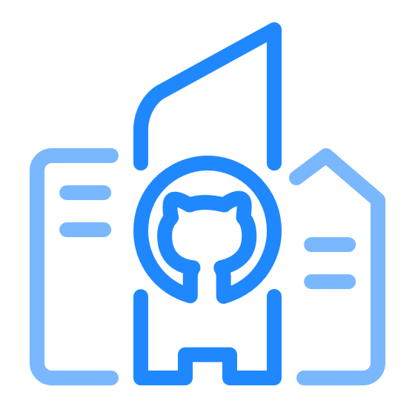
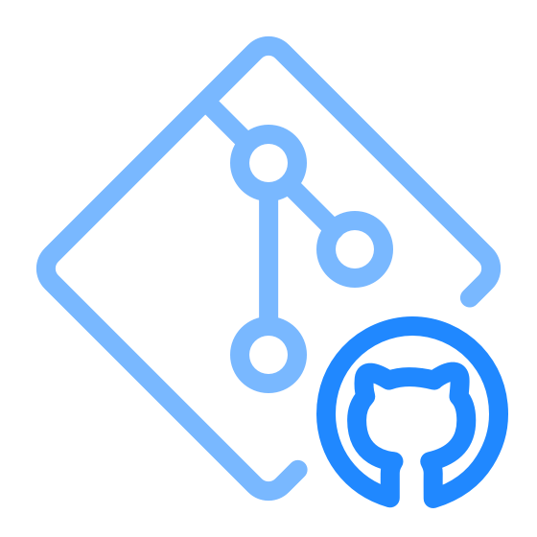

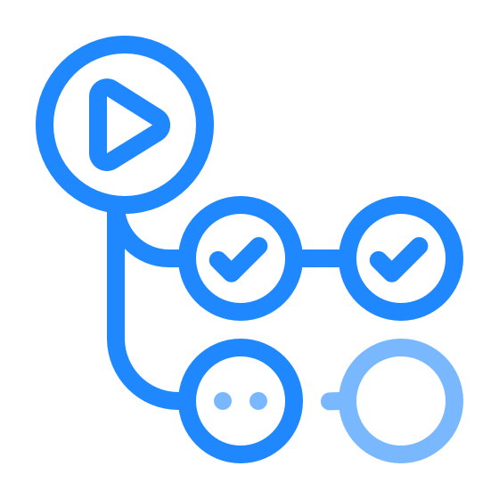
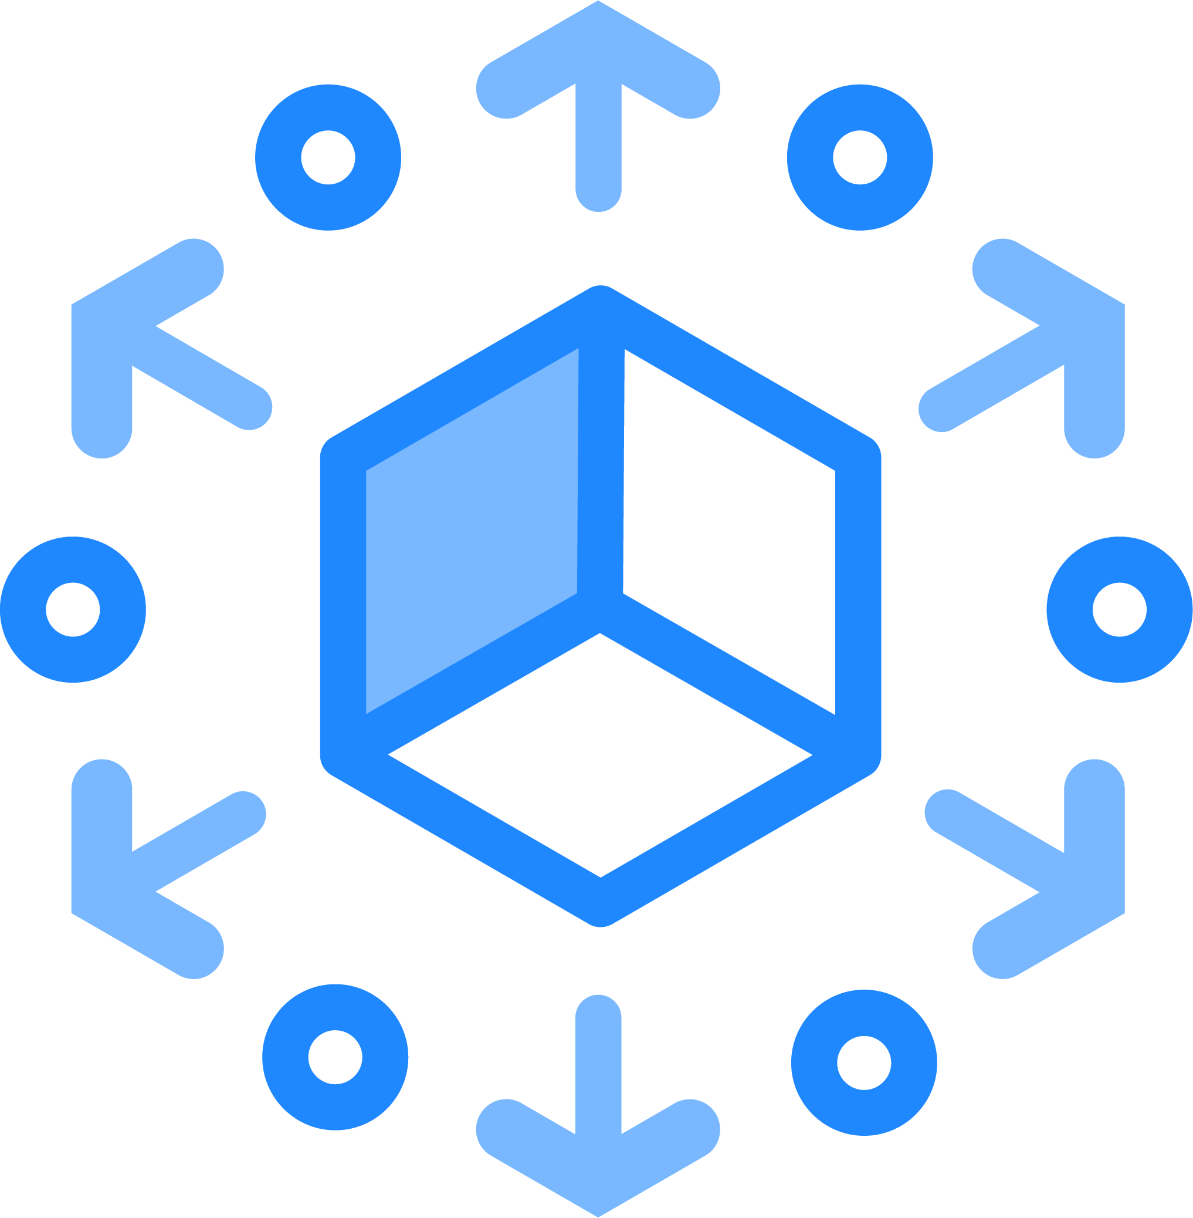


Adopting GitHub
Leverage your Existing Azure DevOps Investment while
Move Repositories to GitHub
Start benefiting from community-centric workflows, wide ecosystem, security features, and connection to the Open Source Community
Keep your builds and/or boards in Azure DevOps
Use your existing build pipelines with repositories in GitHub. Plan your projects with Azure Boards.
Automate non-build workflows with GitHub Actions
Use GitHub Actions to automate non build workflows. YAML Build pipelines can be transitioned to Actions if/when desired.
Use GitHub Package Registry & Azure Artifacts
Store and serve internal packages and containers with GitHub Package Registry. Keep compiled binaries and other artifacts in Azure Artifacts

Slide 100


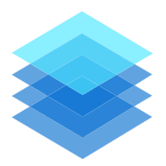




Modern application pattern
Resilient DevOps Practices
Inner Loop
1
8
Feedback Loop
IDE
Code
Dev Cluster
Registry
Test
Staging
Production
Monitor logging
Debug
Container Image
7
Infrastructure Application Deployment
Monitoring
Source control
Pull request
5
2
3
Build/Release
Build
Test/Scan
Deploy
6
Policies for compliance and Governance
GitHub Actions
ARM
Azure Policy
4
Everything as code
Notes:
Highlight
GitHub for SCM
Azure Container Scan
ARM template– validate whether this is the right one
Azure Policy

Slide 101
Azure DevOps Capabilities Not Yet Available in GitHub
General
Admins select where their data lives (data sovereignty)
Dashboards, charts, reports & widgets
Azure Boards
Hierarchical relationships (i.e. Epics, Features, User Stories, Tasks)
First Class Sprint Management
Turn Query Results into charts and dashboard widgets
Analytics widgets – Burn Down, Cycle Time, etc.
WYSIWYG Mark down editing (and copy paste support)
Customizable Boards
Delivery Plans
FREE Stakeholder access
Configure hierarchical teams
Manage product and portfolio backlogs
Modify work items in bulk with Excel
Azure Boards Marketplace Extensions, For example:
Workboard for OKRs (used by Microsoft internally)
Timetracker
Dependency Tracker (created by the Windows team)
Personas
Azure Pipelines
Define variables & Use variable groups
Review test results
Test Analytics
Automated Checks
Build multiple types of source repositories
Azure Artifacts
Publish and download universal packages
Azure Test Plans
Azure Test Plans - Manual, exploratory, and automated test tools (GitHub does not have equivalent functionality)
Wikis
Share info with a Wiki
Under NDA
Notes:
Actions Marketplace count was verified on 1/7/2022

Slide 102
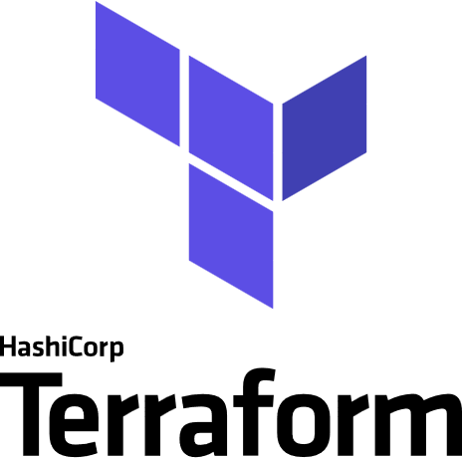

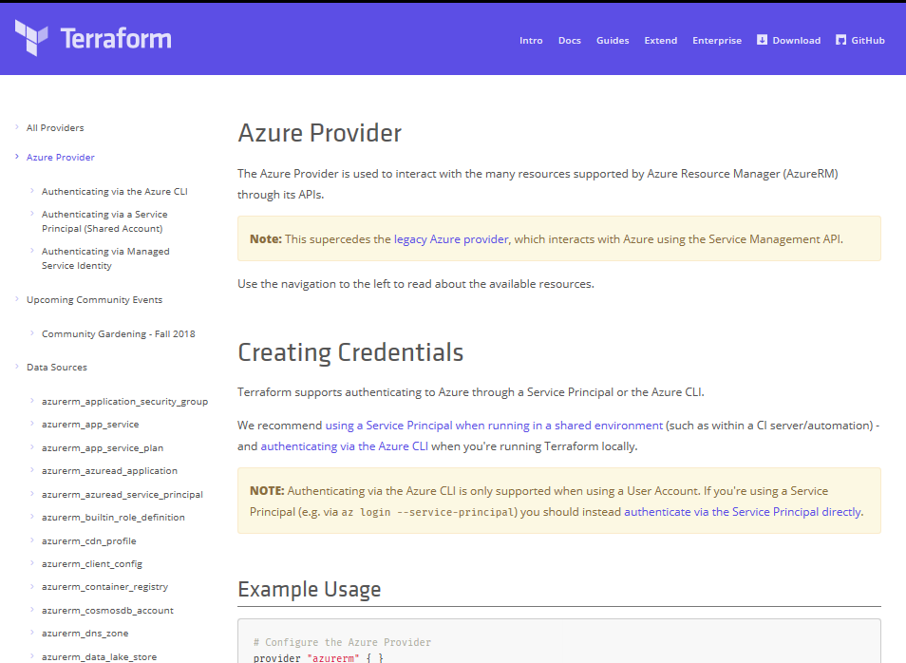
Terraform
Azure DevOps Tool Integrations
Bringing native Azure support for customers using Terraform
Documentation Hub for Terraform
Terraform in Azure Cloud Shell
Azure Resource Provider
Azure Module Registry
Azure Cloud Shell Integration
➔
docs.microsoft.com/azure/terraform
© Microsoft Corporation
Notes:
Decrease time between Terraform support and service releases
Modules
Getting started
Ecosystem integrations

Slide 103









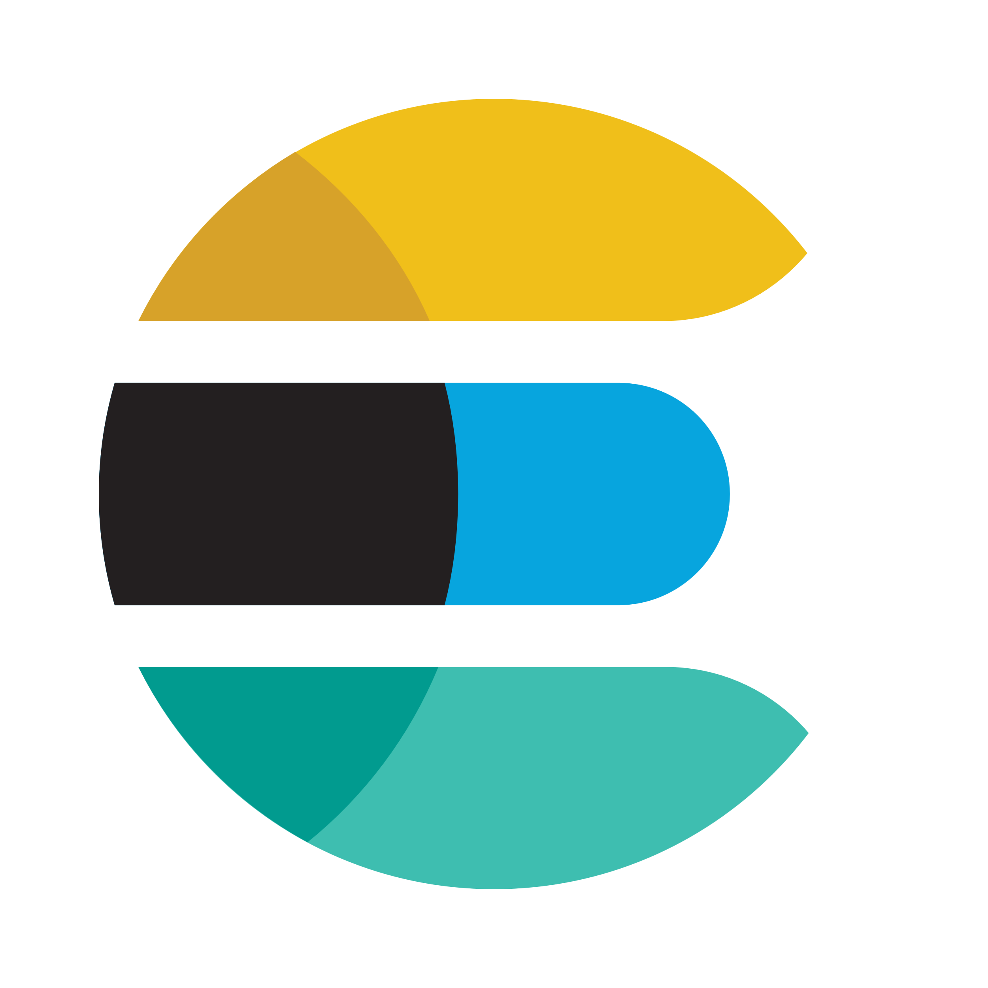

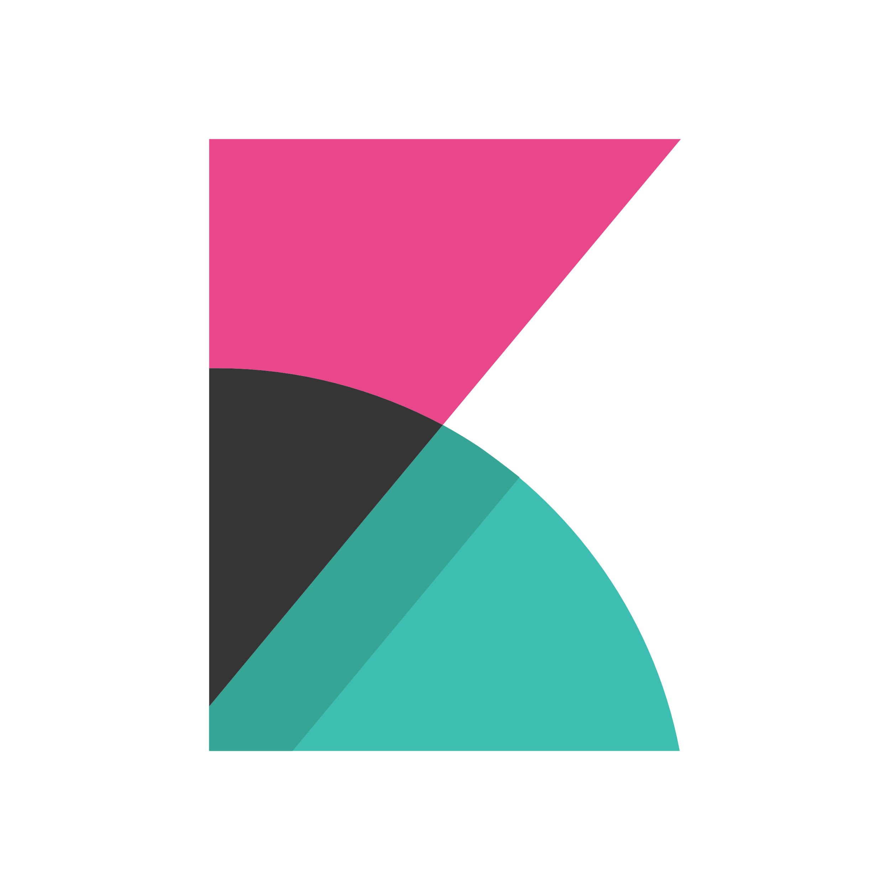
DevOps on Azure framework
Plan and track
Code
Build and test
Deploy
Operate
Monitor
GitHub
Boards
(Azure DevOps)
Repos
(Azure DevOps)
Pipelines & Test Plans
(Azure DevOps)
Artifacts & Pipelines
(Azure DevOps)
Policy
Application
Insights
Trello
GitHub
Jenkins
Terraform
Ansible
ELK Stack
Notes:
Great Azure plays well with VSTS but I already or wants to use OSS tooling. That is just fine. We have great integrations with top OSS tooling.
Tooling enables and allows customers to progress from mutable as well as immutable
Allows customers to work with infra that they are comfortable with be it Virtual Machines, containers, functions …
Deliver continuous innovation faster and more reliably with DevOps and Microsoft Azure.
Azure DevOps provides a fully integrated set of enterprise DevOps services covering the entire DevOps lifecycle. You can use all the Azure DevOps services, or choose just what you need to complement your existing workflows. Azure DevOps is comprised of:
Azure Boards allows you to track work with configurable Kanban boards, interactive backlogs, and powerful planning tools. Combined with the Azure DevOps suite of services, it provides traceability through the entire pipeline, from work item tracking, to code commit, builds and right through deployments.
Azure Repos provide flexible and powerful Git hosting with effective code reviews, start free and scale to unlimited git repositories for all your ideas.
Azure Pipelines allows you to build, test and deploy in any language, to any cloud – or on-premises. Run builds and tests in parallel on Linux, macOS, or Windows, and deploy containers to individual hosts or Kubernetes
Azure Test Plans enables you to improve your overall code quality with manual and exploratory testing tools for your apps.
Azure Artifacts allows you to share Maven, npm, and NuGet packages from public and private sources with your entire team. Integrate package sharing into your CI/CD pipelines in a way that's simple and scalable.
You can also use GitHub Enterprise or GitHub Business cloud for the management of source code, with direct integration into Azure Pipelines to provide an end-to-end solution that leverages the power and familiarity of GitHub, the largest open source community in the world. GitHub is also an open platform supporting a large ecosystem of integrations beyond Azure, that are easily available from the GitHub marketplace.
Azure is open – so If you've already made tooling choices such as Jenkins, Terraform, Ansible or Chef, we provide clear guidance and documentation to help you get started on Azure, fast.
If you’ve made choices in some areas, but have gaps in others, you can take advantage of Azure Pipelines to orchestrate and supplement your end-to-end DevOps toolchain.
Regardless of your toolchain choice, take advantage of the reliable and integrated security, monitoring & management capabilities of the Azure platform such as Azure Policy, Azure Monitor and Application Insights – spend less time fighting fires and more time meeting business requirements

Slide 104
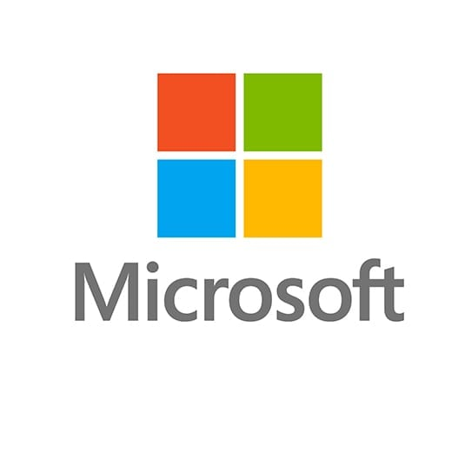


Why do we care ?
Terraform is available natively in cloud shell
MS is contributing to and shipping new Terraform providers approximately every 2 weeks
Terraform provider for Azure Stack (separate to AzureRM), Azure Active Directory
Azure VM Image Builder service is built on Hashicorp Packer
ARM can now leverage Terraform providers (limited)
Under NDA
Notes:
This is not an MS product – should we care?
-Support customer choice
-Accelerate cloud adoption
ARM Resource Provider can use Terraform Providers for Datadog, CLoudFlare, Kubernetes

Slide 105
Platform Automation & DevOps
Where central teams are concerned, CI/CD pipelines should be used to manage policy definitions, role-definitions, policy assignments, and template galleries
The blanket application of a DevOps model will not miraculously establish capable DevOps teams
Establish a cross functional DevOps Platform Team to build, manage and maintain your Enterprise Scale architecture
Planning for a DevOps Approach
Design Recommendation
Notes:
[Auditing and Monitoring]
There is a separate module for monitoring that covers it in detail but in this section we need to talk about the auditing aspects of Enterprise Scale
Is important that landing zones are audited often to ensure the governance and policies are doing their job.
Its also important to be able to keep an eye out for feature changes
One security audit I recently performed the customer did not have HTTPS enable for most of the storage accounts.
This is because this feature was added in later in its lifecycle but the customer was not evolving with the platform
This is the exact type of exposure modern attacks capitalize on the get a foothold in an organization so it important to audit the cloud estate.
To help with this Enterprise Scale turn on logging across all the subscription via policy
For additional auditing concerns, Azure Security Center can be leveraged to measure policy effectiveness with the Secure Score and in the Compliance Dashboard leveraging the Azure Security Benchmarks policy
Right now this is something that has to be turned on after the Enterprise Scale deployment but will soon be on by default
Make sure the visit the Enterprise Scale logging and monitoring module for more details about the Monitoring design

Slide 106
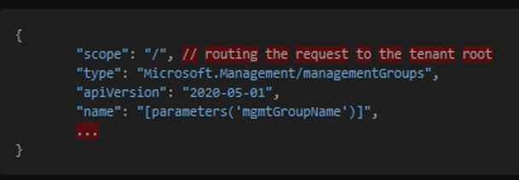
Platform Automation & DevOps
Tenant Root Scope Deployment
Create prescribed management group hierarchy Name of management group
Design Recommendation
Notes:
[Auditing and Monitoring]
There is a separate module for monitoring that covers it in detail but in this section we need to talk about the auditing aspects of Enterprise Scale
Is important that landing zones are audited often to ensure the governance and policies are doing their job.
Its also important to be able to keep an eye out for feature changes
One security audit I recently performed the customer did not have HTTPS enable for most of the storage accounts.
This is because this feature was added in later in its lifecycle but the customer was not evolving with the platform
This is the exact type of exposure modern attacks capitalize on the get a foothold in an organization so it important to audit the cloud estate.
To help with this Enterprise Scale turn on logging across all the subscription via policy
For additional auditing concerns, Azure Security Center can be leveraged to measure policy effectiveness with the Secure Score and in the Compliance Dashboard leveraging the Azure Security Benchmarks policy
Right now this is something that has to be turned on after the Enterprise Scale deployment but will soon be on by default
Make sure the visit the Enterprise Scale logging and monitoring module for more details about the Monitoring design

Slide 107
Platform Automation & DevOps
Deploy the customer’s platform goal state; enabling construction of landing zones
* as declarative Code
Use a single control and management plane
Policy Driven Governance
Azure native; composability and modularity using platform primitives
Consistent GET | PUT pipeline
CI/CD pipeline to deploy ARM templates at scope(s)
No custom orchestration; ARM template job engine
Adopting a DevOps Approach
Design Recommendation
Notes:
[Auditing and Monitoring]
There is a separate module for monitoring that covers it in detail but in this section we need to talk about the auditing aspects of Enterprise Scale
Is important that landing zones are audited often to ensure the governance and policies are doing their job.
Its also important to be able to keep an eye out for feature changes
One security audit I recently performed the customer did not have HTTPS enable for most of the storage accounts.
This is because this feature was added in later in its lifecycle but the customer was not evolving with the platform
This is the exact type of exposure modern attacks capitalize on the get a foothold in an organization so it important to audit the cloud estate.
To help with this Enterprise Scale turn on logging across all the subscription via policy
For additional auditing concerns, Azure Security Center can be leveraged to measure policy effectiveness with the Secure Score and in the Compliance Dashboard leveraging the Azure Security Benchmarks policy
Right now this is something that has to be turned on after the Enterprise Scale deployment but will soon be on by default
Make sure the visit the Enterprise Scale logging and monitoring module for more details about the Monitoring design

Slide 108
Platform Automation & DevOps
Questions?
Notes:
[Auditing and Monitoring]
There is a separate module for monitoring that covers it in detail but in this section we need to talk about the auditing aspects of Enterprise Scale
Is important that landing zones are audited often to ensure the governance and policies are doing their job.
Its also important to be able to keep an eye out for feature changes
One security audit I recently performed the customer did not have HTTPS enable for most of the storage accounts.
This is because this feature was added in later in its lifecycle but the customer was not evolving with the platform
This is the exact type of exposure modern attacks capitalize on the get a foothold in an organization so it important to audit the cloud estate.
To help with this Enterprise Scale turn on logging across all the subscription via policy
For additional auditing concerns, Azure Security Center can be leveraged to measure policy effectiveness with the Secure Score and in the Compliance Dashboard leveraging the Azure Security Benchmarks policy
Right now this is something that has to be turned on after the Enterprise Scale deployment but will soon be on by default
Make sure the visit the Enterprise Scale logging and monitoring module for more details about the Monitoring design

Slide 109
Critical design areas
Enterprise Enrolment and Azure AD Tenants
Identity and Access Management
Management Group and Subscription Organisation
Network Topology and Connectivity
Management and Monitoring
Business Continuity and Disaster Recovery
Security, Governance, and Compliance
Platform Automation and DevOps

Slide 110
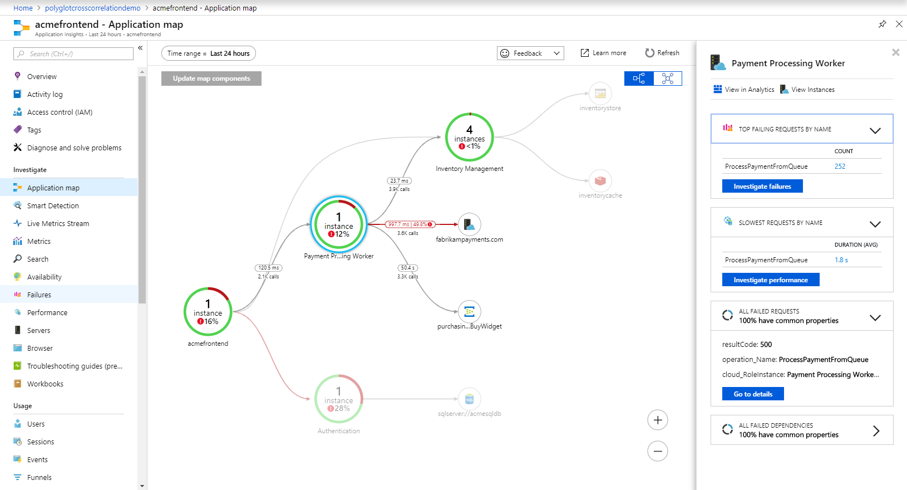
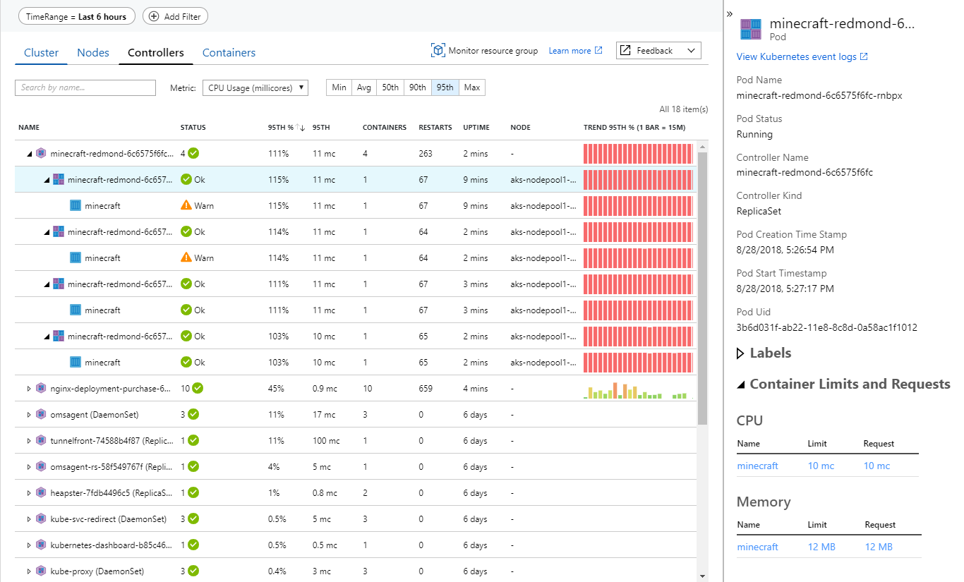
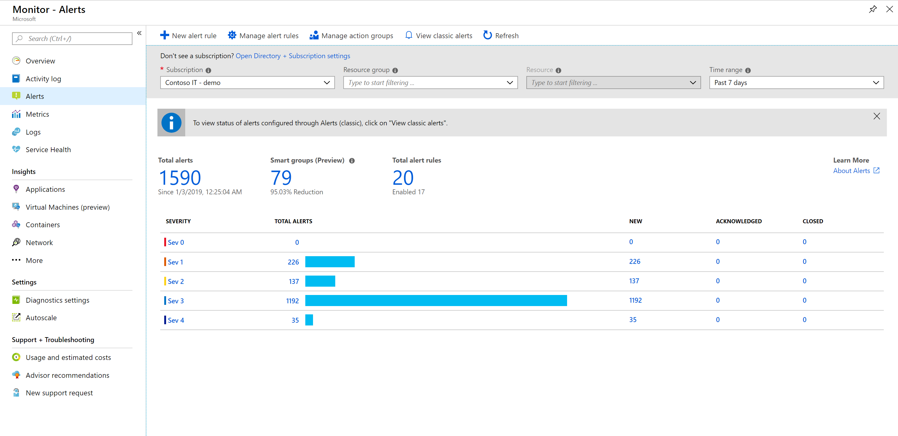
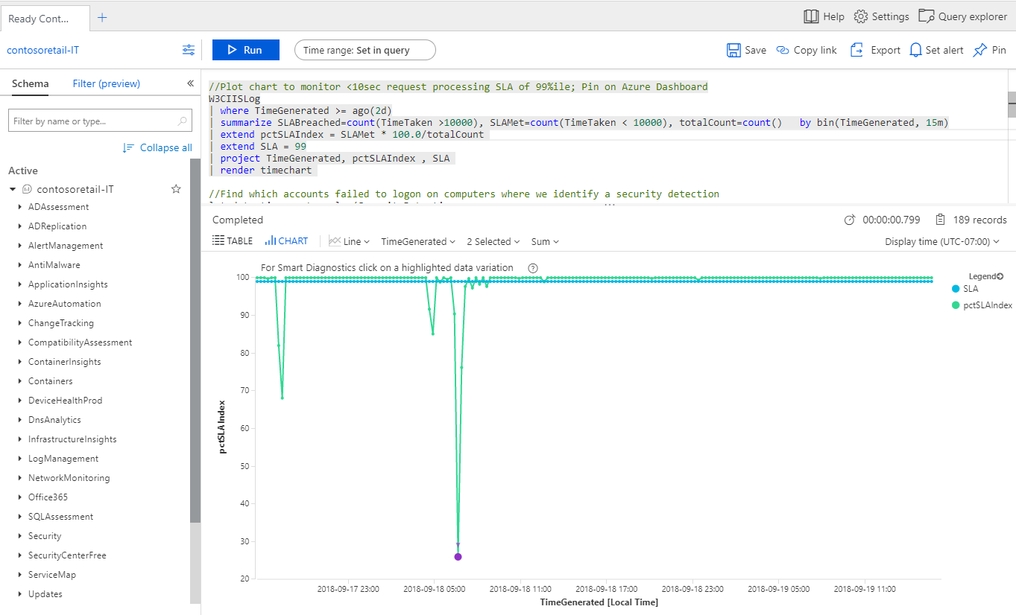
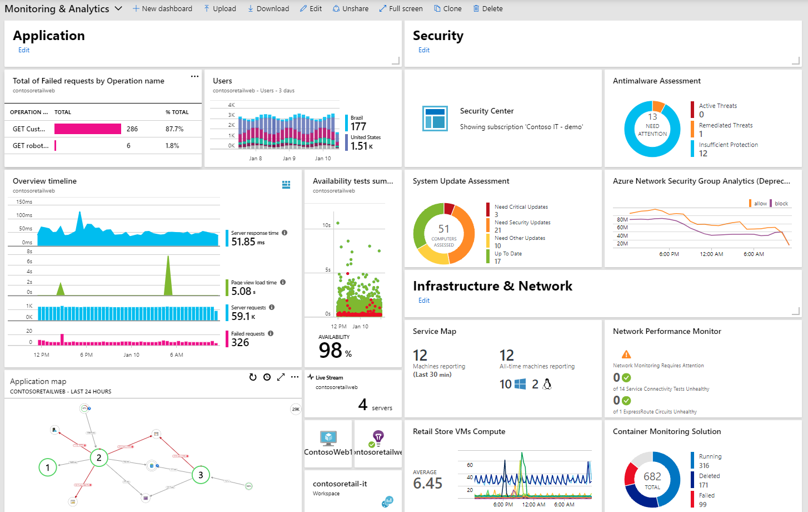
Azure Monitor scenarios
Detect & diagnose issues across apps and dependencies with application insights
Correlate issues at infra level with insights for VMs, containers, SQL, network, etc.
Operationalize at scale with smart alerts and automated actions
Drill down with log analytics for troubleshooting & deeper diagnostics
Create visualizations with Azure dashboards & workbooks

Slide 111
















Azure Monitor
Azure Monitor
Insights
…
Application
Application insights SDK/Agent
Multi-language support
Application
Container
VM
Network
Visualize
Agents
Windows + Linux support
Workload agnostic
Infrastructure
Metrics
Dashboards
Power BI
Workbooks
Analyze
Azure resources
Logs
Metrics explorer
Log analytics
Azure subscription
Zero instrumentation
Logs and metrics
Respond
Azure tenant
Alerts
Action groups
Autoscale
REST APIs
Integrate
Custom sources
Event hubs
Logic apps
Ingest and export APIs

Slide 112
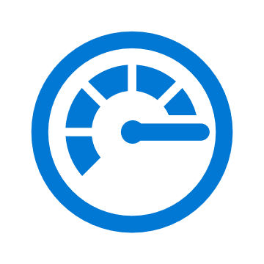

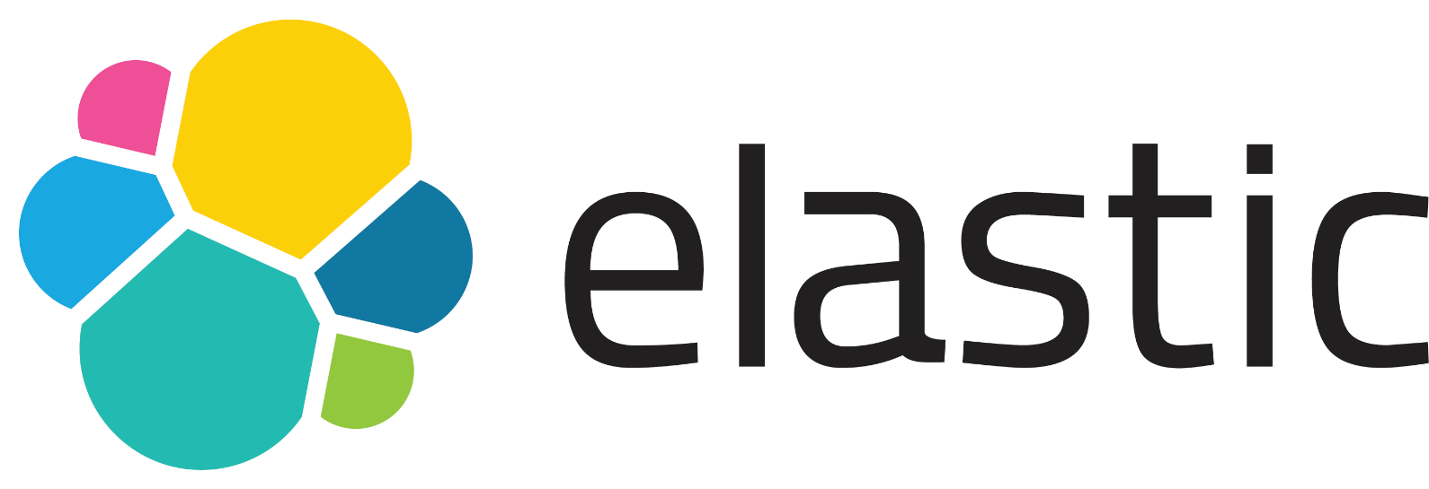







Integrate Azure logs with 3rd party log analysis tools
Azure Monitor
Back-up slide
Application
Operating System
Event Hubs
Azure Resources
Logs
Integrate
APIs
Azure Subscription
Collect
Azure Tenant
Logic Apps
Custom Sources
Notes:
Getting Microsoft Azure Data into Splunk | Splunk

Slide 113


Integrate alerts with partner services
Back-up slide
Azure Monitor
Service Now
ITSM Integrations
Cherwell
Application
Provance
Webhooks
Operating System
Metrics
Automation Runbook
Azure Resources
Respond
Logic Apps
Azure Subscription
Alerts
Collect
Logs
Azure Tenant
Azure Functions
SMS/Email/ Voice/Mobile App
Custom Sources
Notes:
ITSM connector allow you to send alerts to external ticketing system such as Service Now.
IT Service Management Connector overview - Azure Monitor | Microsoft Docs

Slide 114

Ensuring monitoring at scale
Back-up slide
Configuration
Deploy Azure Monitor Agent & enable Diagnostic Settings via ARM Templates, Azure CLI, PowerShell or Azure Automation DSC
Integrate monitoring as part of CI/CD workflows (Azure Pipelines/Azure DevOps Projects/Terraform)
Management
Enable out-of-the-box Azure Policy Initiatives for Azure Monitor (VM Insights & Diagnostic Settings)
Leverage Management Groups to prevent monitoring blind spots
Manage multiple tenants via Azure Lighthouse
Visualization
Customize Workbooks for aggregated reports across resources
Build diagnostic or KPI Dashboards in Azure, Power BI or Grafana
Operationalization
Setup Multi-resource Alerts that grow flexibly with your resources
Use Dynamic Thresholds to enable scalable ML powered alerts for metrics
Use Action Rules to manage Alert Suppression & Actions at scale

Slide 115

Management & Monitoring
To plan for workload management and monitoring, consider the following factors:
Workload monitoring in dedicated Azure Monitor Log Analytics workspaces
For workloads that are deployed to virtual machines (VMs), store logs relative to dedicated Log Analytics workspaces. Workload team members can access logs for their workloads or VMs according to their Azure role-based access control (RBAC) roles
Performance and health monitoring for both infrastructure-as-a-service (IaaS) and platform-as-a-service (PaaS) resources
Data aggregation across all workload components
Health modeling and operationalization:
How to measure the health of the workload and its subsystems.
A traffic-light model to represent health.
How to respond to failures across workload components
Workload Management and Monitoring
Design Considerations
Notes:
KEY POINTS:

Slide 116

Management & Monitoring
Policies for Management and Monitoring
Operational guard rails​
Management-as-code​
Management on by default
Design Considerations
Notes:
KEY POINTS:

Slide 117
Management & Monitoring
You can use centralized Azure Monitor components to manage and monitor workloads:
Use a centralized Log Analytics workspace to collect logs and metrics from IaaS and PaaS workload resources.
Control workspace and log access with Azure RBAC. For more information, see Azure Monitor access control overview
Use Azure Monitor Metrics for time-sensitive analysis
Workload management and monitoring
Design Recommendation
Notes:
Azure Monitor Logs (aka Log Analytics)
Centralized logging is critical to the visibility that's required by the operations management teams. The centralization of logging drives reports about change management, service health, configuration, and most other aspects of IT operations. Converging on a centralized workspace model reduces administrative effort and reduces the chances for gaps in observability.
Design recommendations:
Use a single monitor logs workspace to manage platforms centrally except where role-based access control (RBAC) and data sovereignty requirements mandate separate workspaces. Centralized logging is critical to the visibility required by operations management teams. Logging centralization drives reports about change management, service health, configuration, and most other aspects of IT operations. Converging on a centralized workspace model reduces administrative effort and the chances for gaps in observability.
In the context of the enterprise-scale architecture, centralized logging is primarily concerned with platform operations. This doesn't preclude the use of the same workspace for VM-based application logging. With a workspace configured in resource-centric access control mode, granular RBAC is enforced to ensure app teams will only have access to the logs from their resources. In this model, app teams benefit from the use of existing platform infrastructure by reducing their management overhead. For any non-compute resources (such as web apps or Azure Cosmos DB databases), application teams can use their own Log Analytics workspaces and configure diagnostics and metrics to be routed here.
Use a centralized Azure Monitor Log Analytics workspace to collect logs and metrics from IaaS and PaaS app resources and control log access with RBAC.
Do not send raw log entries back to on-premises monitoring systems. Instead, adopt a principle that data born in Azure stays in Azure. If on-premises SIEM integration is required, then send critical alerts instead of logs.
Link Automation Account
In Azure Automation, you can enable the Update Management, Change Tracking and Inventory, and Start/Stop VMs during off-hours features for your VMs. However, only certain regions are supported for linking a Log Analytics workspace and an Automation account in your subscription. The region mappings only apply to the Automation account and the Log Analytics workspace. The Log Analytics workspace and Automation account must be in the same subscription but can be in different resource groups deployed to the same region.
Knowledge check:
Which feature does not require linking of Azure Automation account with Azure Monitor Logs Workspace
Change tracking
Inventory
Update management
Resource-centric access control mode

Slide 118
Management & Monitoring
Azure Monitor stores metrics in a time-series database optimized to analyze time-stamped data. Metrics are well suited for alerts and detecting issues quickly. Metrics can also monitor system performance. You can combine metrics with logs to identify the root causes of issues
Use Azure Monitor Logs for insights and reporting
Workload management and monitoring
Design Recommendation
Notes:
Azure Monitor Logs (aka Log Analytics)
Centralized logging is critical to the visibility that's required by the operations management teams. The centralization of logging drives reports about change management, service health, configuration, and most other aspects of IT operations. Converging on a centralized workspace model reduces administrative effort and reduces the chances for gaps in observability.
Design recommendations:
Use a single monitor logs workspace to manage platforms centrally except where role-based access control (RBAC) and data sovereignty requirements mandate separate workspaces. Centralized logging is critical to the visibility required by operations management teams. Logging centralization drives reports about change management, service health, configuration, and most other aspects of IT operations. Converging on a centralized workspace model reduces administrative effort and the chances for gaps in observability.
In the context of the enterprise-scale architecture, centralized logging is primarily concerned with platform operations. This doesn't preclude the use of the same workspace for VM-based application logging. With a workspace configured in resource-centric access control mode, granular RBAC is enforced to ensure app teams will only have access to the logs from their resources. In this model, app teams benefit from the use of existing platform infrastructure by reducing their management overhead. For any non-compute resources (such as web apps or Azure Cosmos DB databases), application teams can use their own Log Analytics workspaces and configure diagnostics and metrics to be routed here.
Use a centralized Azure Monitor Log Analytics workspace to collect logs and metrics from IaaS and PaaS app resources and control log access with RBAC.
Do not send raw log entries back to on-premises monitoring systems. Instead, adopt a principle that data born in Azure stays in Azure. If on-premises SIEM integration is required, then send critical alerts instead of logs.
Link Automation Account
In Azure Automation, you can enable the Update Management, Change Tracking and Inventory, and Start/Stop VMs during off-hours features for your VMs. However, only certain regions are supported for linking a Log Analytics workspace and an Automation account in your subscription. The region mappings only apply to the Automation account and the Log Analytics workspace. The Log Analytics workspace and Automation account must be in the same subscription but can be in different resource groups deployed to the same region.
Knowledge check:
Which feature does not require linking of Azure Automation account with Azure Monitor Logs Workspace
Change tracking
Inventory
Update management
Resource-centric access control mode

Slide 119
Management & Monitoring
Logs contain different types of data organized into records with different sets of properties. Logs are useful for analyzing complex data from a range of sources, such as performance data, events, and traces. If necessary, use shared storage accounts in the landing zone for Azure diagnostic extension log storage
Use Azure Monitor alerts for generating operational alerts. Azure Monitor alerts unify metric and log alerts, and use features like actions and smart groups for advanced management and remediation
Workload management and monitoring
Design Recommendation
Notes:
Azure Monitor Logs (aka Log Analytics)
Centralized logging is critical to the visibility that's required by the operations management teams. The centralization of logging drives reports about change management, service health, configuration, and most other aspects of IT operations. Converging on a centralized workspace model reduces administrative effort and reduces the chances for gaps in observability.
Design recommendations:
Use a single monitor logs workspace to manage platforms centrally except where role-based access control (RBAC) and data sovereignty requirements mandate separate workspaces. Centralized logging is critical to the visibility required by operations management teams. Logging centralization drives reports about change management, service health, configuration, and most other aspects of IT operations. Converging on a centralized workspace model reduces administrative effort and the chances for gaps in observability.
In the context of the enterprise-scale architecture, centralized logging is primarily concerned with platform operations. This doesn't preclude the use of the same workspace for VM-based application logging. With a workspace configured in resource-centric access control mode, granular RBAC is enforced to ensure app teams will only have access to the logs from their resources. In this model, app teams benefit from the use of existing platform infrastructure by reducing their management overhead. For any non-compute resources (such as web apps or Azure Cosmos DB databases), application teams can use their own Log Analytics workspaces and configure diagnostics and metrics to be routed here.
Use a centralized Azure Monitor Log Analytics workspace to collect logs and metrics from IaaS and PaaS app resources and control log access with RBAC.
Do not send raw log entries back to on-premises monitoring systems. Instead, adopt a principle that data born in Azure stays in Azure. If on-premises SIEM integration is required, then send critical alerts instead of logs.
Link Automation Account
In Azure Automation, you can enable the Update Management, Change Tracking and Inventory, and Start/Stop VMs during off-hours features for your VMs. However, only certain regions are supported for linking a Log Analytics workspace and an Automation account in your subscription. The region mappings only apply to the Automation account and the Log Analytics workspace. The Log Analytics workspace and Automation account must be in the same subscription but can be in different resource groups deployed to the same region.
Knowledge check:
Which feature does not require linking of Azure Automation account with Azure Monitor Logs Workspace
Change tracking
Inventory
Update management
Resource-centric access control mode

Slide 120

Management & Monitoring
Application VM backup on by default​
Policy driven backup schedules​
On by default​
Policy driven vault deployment​
Diagnostics on by default​
Workbooks provide holistic view across estate
VM Backup
Design Considerations
Notes:
Azure Backup removes the need for managing third-party backup software and infrastructure. As with other native features, backup configurations can be set, audited, and enforced with Azure Policy, ensuring that services remain compliant with the organization's requirements.
VM backup should be driven by policy to ensure backups are enabled for all VMs when they are deployed. Enterprise-scale policies will:
Create the recovery services vault, if one does not already exist, in the same RG as the VM
Associate VM to the appropriate vault and enable backup schedule
Ensure vault diagnostic settings are sending logs to platform LA workspace
Workbooks can be used for holistic view of vaults and backups across the Azure estate.
Knowledge check:
Which cannot be backed up by Azure Backup?
Azure VMs
SAP HANA databases in Azure VMs
SQL Server in Azure VMs
Oracle databases in Azure VMs

Slide 121
Management & Monitoring
Questions?
Notes:
Dashboards
The goal within Enterprise-scale for visualizations is a curated set of dashboards built for specific personas in the operating model.
Azure Workbooks are the platform visualization capability where current development efforts are focused.
Workbooks provide a flexible canvas for data analysis and the creation of rich visual reports within the Azure portal. They allow you to tap into multiple data sources from across Azure and combine them into unified interactive experiences.
Workbooks can query data from multiple sources within Azure. Authors of workbooks can transform this data to provide insights into the availability, performance, usage, and overall health of the underlying components. For instance, analyzing performance logs from virtual machines to identify high CPU or low memory instances and displaying the results as a grid in an interactive report.
But the real power of workbooks is the ability to combine data from disparate sources within a single report. This allows for the creation of composite resource views or joins across resources enabling richer data and insights that would otherwise be impossible.
Workbooks are currently compatible with the following data sources:
Logs
Metrics
Azure Resource Graph
Alerts (Preview)
Workload Health (Preview)
Azure Resource Health (Preview)
Azure Data Explorer (Preview)

Slide 122
Critical design areas
Enterprise Enrolment and Azure AD Tenants
Identity and Access Management
Management Group and Subscription Organisation
Network Topology and Connectivity
Management and Monitoring
Business Continuity and Disaster Recovery
Security, Governance, and Compliance
Platform Automation and DevOps

Slide 123

Business Continuity & Disaster Recovery
Application and data availability requirements
RTO and RPO requirements for each workload
Support for active-active and active-passive availability patterns
BCDR as a service for PaaS services:
Native DR and high-availability (HA) feature support.
Geo-replication and DR capabilities for PaaS services
Multiregion deployments for failover
Workload suitability for Availability Zones or Availability Sets
Consistent backups for applications and data:
VM snapshots.
Azure Backup Recovery Services vaults
Network connectivity if a failover occurs: bandwidth capacity planning and traffic routing
Planned and unplanned failovers:
IP address consistency requirements.
Maintaining engineering DevOps capabilities.
Azure Key Vault DR for application keys, certificates, and secrets.
Design Considerations
Notes:
KEY POINTS:

Slide 124
Business Continuity & Disaster Recovery
Employ Azure Site Recovery for Azure-to-Azure VM DR scenarios
Use native PaaS DR capabilities.
Use Azure-native backup capabilities. Use 3rd party if needed
Use multiple regions and peering locations for ExpressRoute connectivity
Avoid using overlapping IP address ranges for production and DR sites.
Composite SLA calculations, depending on the services and options chosen
Planning for BCDR
Design Recommendation
Notes:
Having a business continuity and disaster recovery plan is essential for organizations as it aids in the time it will take for an organization to resume work in the aftermath of an unforeseen outage or disaster. Organizations are required to define their recovery time objective (RTO) which is the time it takes for an organizations infrastructure to recover and the recovery point objective (RPO) which measures the amount of data loss after the outage or disaster for their application and data availability during the planning phases for their BCDR plan. Application and data availability requirements will differ from organization to organization based on their RTO and RPO requirements. Microsoft Azure's backup service and Azure Site Recovery service both make up the Business Continuity and Disaster Recovery solution in Azure.
This diagram is a holistic review of Enterprise-scale, the section that is relevant to Enterprise scale is what has been highlighted, the backup policy. Backups of an organizations data is a must and critical for the restoration of data.
Backup policies in Enterprise-scale are guardrails that enable and enforce backups.
The backup policy should be configured to align with the organizations recovery point objective (RPO).
Azure backups for PaaS services eliminates the need for 3rd party backup software.
Like traditional backup software, backup policies can be configured, audited, enabled, and enforced with Azure policy to enforce compliance within an organization.
Backup diagnostic data should be collected in a central Log Analytics instance to provide a horizontal view over the backup estate as a whole.
The "Deploy Backup Vault and enforce backup settings for Windows and Linux VMs" policy should be used to deploy the backup vault and enable the backup. The scope for the policy should be the landing zone management group. When used, every resource group with virtual machines in the landing zone subscription will have a backup vault for all virtual machines to backup to.
The "Add diagnostic setting to backup vault" policy should be used to link the backup vault diagnostics to the central log analytics instance. The scope that the policy should be assigned to is the landing zone management group. Doing this creates a horizontal view for all of the virtual machine backups.
When the native backup solution (Azure Backup) can't be used, other options will need to be considered to ensure data consistency and business continuity.
Why are backup policies important? A common issues across organizations when there is no enforcement of backups is that backups aren't configured or configured properly simply by human error. When there is no backup of data and\or resources, there is nothing to restore from. Backup policies eliminates the need to manually configure backups altogether. When the policy is set up, the policy configures the backup automatically.
High Availability
Applications should be deployed using availability zones within the same region
When there is an option to use replication across availability zones for native Azure services, Enterprise-scale recommends it is used. Some examples of this would be Zone redundant storage and Azure SQL DB.
Load balancers or Application Gateways should be used on the backend for stateless virtual machine workloads that are deployed across multiple instances in Availability Zones.
Application-level replication should be used for stateful virtual machine workloads across Availability Zones. An example of this would be SQL AlwaysOn.
Disaster Recovery
Applications and its corresponding data should be asynchronously replicated across multiple paired regions.
Applications architectures should enforce the use of native replication options for stateful virtual machines to replicate data between regions in region pairs. One example is the SQL AlwaysOn.
Azure Site Recovery should be used for applications to replicate stateful IaaS virtual machines that does not support application-level replication.
Externally facing applications that are required to be available always, active/active or active/passive deployment patterns across multiple regions should be utilized. Azure Front Door or Azure Traffic Manager should be used to ensure application availability should one of the regions become unavailable.
Overlapping IP address ranges must be avoided for production and DR sites to prevent connection issues.
When possible, applications should be revamped and modernized to take advantage of Azure PaaS services that provide native replication across region pairs. An example of some services that provide native replication across multiple regions are Cosmo DB, Azure SQL DB, and Azure Key Vault.
Side note: When planning for Azure Pass deployments database backups should be isolated from KeyVault backups in separate storage accounts.

Slide 125
Business Continuity & Disaster Recovery
Questions?
Notes:
Having a business continuity and disaster recovery plan is essential for organizations as it aids in the time it will take for an organization to resume work in the aftermath of an unforeseen outage or disaster. Organizations are required to define their recovery time objective (RTO) which is the time it takes for an organizations infrastructure to recover and the recovery point objective (RPO) which measures the amount of data loss after the outage or disaster for their application and data availability during the planning phases for their BCDR plan. Application and data availability requirements will differ from organization to organization based on their RTO and RPO requirements. Microsoft Azure's backup service and Azure Site Recovery service both make up the Business Continuity and Disaster Recovery solution in Azure.
This diagram is a holistic review of Enterprise-scale, the section that is relevant to Enterprise scale is what has been highlighted, the backup policy. Backups of an organizations data is a must and critical for the restoration of data.
Backup policies in Enterprise-scale are guardrails that enable and enforce backups.
The backup policy should be configured to align with the organizations recovery point objective (RPO).
Azure backups for PaaS services eliminates the need for 3rd party backup software.
Like traditional backup software, backup policies can be configured, audited, enabled, and enforced with Azure policy to enforce compliance within an organization.
Backup diagnostic data should be collected in a central Log Analytics instance to provide a horizontal view over the backup estate as a whole.
The "Deploy Backup Vault and enforce backup settings for Windows and Linux VMs" policy should be used to deploy the backup vault and enable the backup. The scope for the policy should be the landing zone management group. When used, every resource group with virtual machines in the landing zone subscription will have a backup vault for all virtual machines to backup to.
The "Add diagnostic setting to backup vault" policy should be used to link the backup vault diagnostics to the central log analytics instance. The scope that the policy should be assigned to is the landing zone management group. Doing this creates a horizontal view for all of the virtual machine backups.
When the native backup solution (Azure Backup) can't be used, other options will need to be considered to ensure data consistency and business continuity.
Why are backup policies important? A common issues across organizations when there is no enforcement of backups is that backups aren't configured or configured properly simply by human error. When there is no backup of data and\or resources, there is nothing to restore from. Backup policies eliminates the need to manually configure backups altogether. When the policy is set up, the policy configures the backup automatically.
High Availability
Applications should be deployed using availability zones within the same region
When there is an option to use replication across availability zones for native Azure services, Enterprise-scale recommends it is used. Some examples of this would be Zone redundant storage and Azure SQL DB.
Load balancers or Application Gateways should be used on the backend for stateless virtual machine workloads that are deployed across multiple instances in Availability Zones.
Application-level replication should be used for stateful virtual machine workloads across Availability Zones. An example of this would be SQL AlwaysOn.
Disaster Recovery
Applications and its corresponding data should be asynchronously replicated across multiple paired regions.
Applications architectures should enforce the use of native replication options for stateful virtual machines to replicate data between regions in region pairs. One example is the SQL AlwaysOn.
Azure Site Recovery should be used for applications to replicate stateful IaaS virtual machines that does not support application-level replication.
Externally facing applications that are required to be available always, active/active or active/passive deployment patterns across multiple regions should be utilized. Azure Front Door or Azure Traffic Manager should be used to ensure application availability should one of the regions become unavailable.
Overlapping IP address ranges must be avoided for production and DR sites to prevent connection issues.
When possible, applications should be revamped and modernized to take advantage of Azure PaaS services that provide native replication across region pairs. An example of some services that provide native replication across multiple regions are Cosmo DB, Azure SQL DB, and Azure Key Vault.
Side note: When planning for Azure Pass deployments database backups should be isolated from KeyVault backups in separate storage accounts.

Slide 126
Resources
Get ready to deploy guidance on Cloud Adoption Framework
Learn more about the Design Principles for Enterprise-scale
Drill down into the Enterprise-scale Design Guidelines to build your environment
Configure your environment using the reference implementation guide
Leverage the Enterprise-scale landing zones template schema
Design Application with our Well-Architecture Framework in mind
Let’s get started and build your enterprise-scale landing zone for successful deployment and use of Azure

Slide 127
Questions? Next steps?

Slide 128
Thank You

Slide 129
Appendix

Slide 130

Why to use multiple tenants?
Organizations with different business divisions, each with a different market or model of operation
Global businesses with regional or country models that differ to account for variations in approach, market size, or compliance with legal and regulatory constraints
In these types of business environments, an organization often will have common sets of functionality that allow specific regions, countries, or business areas with a degree of localization
A multi-tenant deployment
Notes:
A single-tenant architecture is recommended for smaller institutions. However, for organizations that have over 1 million users we recommend a multi-tenant architecture to mitigate performance issues and tenant limitations such as Azure subscription and quotas and Azure AD service limits and restrictions.
This critical design area focuses on the two highest levels of alignment across all of your Azure deployments; your Azure billing offer and the association of that offer with an Azure Active Directory (Azure AD) tenant.
The objective of this exercise is to evaluate the various offer types and Azure Active Directory tenant association is best suited for your overall environment.
Departments help to segment costs into logical groupings and set a budget or quota at the department level. The quota isn't firmly enforced; it's used for reporting purposes.
Accounts are organizational units in the Azure EA portal. They can be used to manage subscriptions and access reports.
Subscriptions are the smallest units in the Azure EA portal. They're containers for Azure services that are managed by a Service Administrator. This is where your organization deploys Azure services

Slide 131
Scenario for multiple tenants
A licensed user associated with a tenant can only access one or more environments mapped to the same tenant. To access another tenant a user would need a separate license and a unique set of sign-in credentials for that tenant
You cannot reassign licenses between tenant enrollments. An enrolled affiliate can use license reduction under one enrollment and add licenses to another enrollment to facilitate this
On-premises Active Directory federation cannot be established with more than one tenant unless you have top-level domains that you need to federate with different tenants (for example Contoso.com and Fabricam.com)
A multi-tenant deployment
Notes:
For example, if User A has an account to access Tenant A their license allows them to access any and all environments created within Tenant A - if they are allowed by their administrator. If User A needs to access environments within Tenant B, they will need an additional license.

Slide 132
Constraints of multiple tenants
Admins who want to deploy and manage multiple tenants should be aware of the following:
User accounts, identities, security groups, subscriptions, licenses, and storage cannot be shared among tenants
A single domain can only be federated with one tenant
Each tenant must have its own namespace; UPN or SMTP namespaces cannot be shared across tenants
If an on-premises Exchange organization exists, you cannot split this organization across multiple tenants
There can be no duplicate accounts across the tenants or partitions in the on-premises Active Directory
A multi-tenant deployment
Notes:
For example, if User A has an account to access Tenant A their license allows them to access any and all environments created within Tenant A - if they are allowed by their administrator. If User A needs to access environments within Tenant B, they will need an additional license.

Slide 133

Properties of an Azure Active Directory B2B collaboration user
External member: This B2B collaboration user has an account in an external Azure AD organization or an external identity provider (such as a social identity) and member-level access to resources in your organization. This scenario is common in organizations consisting of multiple tenants, where users are considered part of the larger organization and need member-level access to resources in the organization’s other tenants. The user object created in the resource Azure AD directory has a UserType of Member
Properties of a B2B guest user - Azure Active Directory - Microsoft Entra | Microsoft Docs
Notes:
In some cases, a resource tenant might want to treat users from the home tenant as members instead of guests. if so, you can use the Azure AD B2B Invitation Manager APIs to add or invite a user from the home tenant to the resource tenant as a member. For more information, see Properties of an Azure Active Directory B2B collaboration user.
In an Azure AD cross-tenant scenario, the resource organization can create Conditional Access policies that require MFA or device compliance for all guest and external users. Generally, an external user accessing a resource is required to set up their Azure AD MFA with the resource tenant.

Slide 134


Authentication flow for external Azure AD users
Authentication flow for external ​ Azure AD users
Notes:
For example, if User A has an account to access Tenant A their license allows them to access any and all environments created within Tenant A - if they are allowed by their administrator. If User A needs to access environments within Tenant B, they will need an additional license.

Slide 135

Azure AD Connect Components
Azure Active Directory Connect is made up of three primary components:
Synchronization services
Active Directory Federation Services (optional)
Azure AD Connect Health

Slide 136
At glance comparison
 | Azure AD join | Hybrid Azure AD join
Definition | Joined only to Azure AD requiring organizational account to sign-in to the device | Joined to on-premises Active Directory and Azure AD requiring organizational account to sign-in to the device
Primary audience | Suitable for both cloud-only and hybrid organizations Applicable to all users in an organization | Suitable for hybrid organizations with existing on-premises Active Directory infrastructure Applicable to all users in an organization
Device ownership | Organization | Organization
Device types | All Windows 10 and Windows 11 devices | Windows 11, Windows 10, Windows 8.1, and Windows 7 Windows Server 2008, Windows Server 2008 R2, Windows Server 2012, Windows Server 2012 R2, Windows Server 2016, Windows Server 2019, Windows Server 2022
Provisioning | Windows out-of-box-experiences or settings Bulk enrollment Windows Autopilot | Domain-joined by IT and auto-joined using Azure AD Connect or Azure Active Directory Federation Services (AD FS) configuration Domain-joined by Windows Autopilot and auto-joined using Azure AD Connect or AD FS configuration
Device sign-in options | Organizational accounts using: Password Windows Hello for Business FIDO 2.0 security keys (preview) Smart-Card | Organizational accounts using: Password Windows Hello for Business FIDO 2.0 security keys (preview) Smart-Card
Management | Mobile device management (MDM) (For example, Intune) Co-management with Intune and System Center Configuration Manager | Group Policy Configuration Manager standalone or co-management with Intune
Key capabilities | SSO to both cloud and on-premises resources Conditional Access when enrolled in MDM (like Intune) Self-service password reset on lock screen | SSO to both cloud and on-premises resources Conditional Access through domain join or through Intune if co-managed Self-service password reset on lock screen

Slide 137
Limitations of Hybrid Join
Still requires on-prem connectivity (HAADJ does not solve remote work pains)
De-synchronized credentials
SSPR/forgotten password
GPO is just a bad way to manage devices
No reporting
No off-premises refresh
Hello for business woes
Bunch of on-prem connectivity requirements
No Web sign-in support
No TAP for OOBE

Slide 138
Considerations for Hybrid Azure AD join
SUPPORTED SCENARIOS
SUPPORTED DEVICES
SUPPORTED ENVIRONMENTS
THINGS TO KNOW
SSO across on-premises and cloud apps
Conditional Access to protect cloud and on-premises resources
Requires device writeback for on-premises CA via ADFS
Self-service Password Reset
Requires password writeback and on-prem connectivity to reset from lock-screen
Windows Hello for Business
Requires device writeback for some scenarios (Hybrid cert trust via ADFS)
FIDO
Unlock only, no OOBE
Windows current devices (domain-joined)
Federated Domains using AD FS
When using Sysprep, or VM snapshot make sure the device has not been Hybrid Azure AD joined (fixed in 1809).
Windows down-level configured for user profile roaming or credential roaming is not supported.
Windows current device is registered in the context of the system, whereas Windows down-level is registered in the context of the user.
Windows Server running DC is not supported.
Automatic on Windows 10+ and Windows Server 2016+
Requires SCP and AD FS claim rules to be configured.
Join is instantaneous, uses Azure AD Connect as a fallback for Windows 10.
Windows down-level devices (domain-joined)
Managed Domains using Seamless SSO
Requires MSI on Windows 8.1, Windows 7, Windows Server 2012 R2, Windows Server 2012 and Windows Server 2008 R2
Requires SCP to be configured.
Relies on Azure AD Connect for Windows 10.
Federated Domains using 3rd party IDP
Requires SCP to be configured.
Requires support for WS-Fed and WS-Trust.

Slide 139
Limitations of AADJ
No LAPS (yet)
Other alternatives available https://docs.microsoft.com/en-us/azure/active-directory/devices/assign-local-admin
No Machine AuthN against AD (NTLM/Kerberos)
Wifi auth with 802.1x and certs (EAP) can be worked around with intune and some smart scripting
Some RDP scenario limitations (for few more months)

Slide 140
Consideration for Azure AD join
SUPPORTED SCENARIOS
SUPPORTED DEVICES
SUPPORTED ENVIRONMENTS
THINGS TO KNOW
SSO across on-premises and cloud apps
Conditional Access to protect cloud and on-premise resources
Requires device writeback for on-premises CA via ADFS
Self-service Password Reset
Requires password writeback
Windows Hello for Business
FIDO
Supported for OOBE and unlock
Windows 10+ Devices
All applicable configurations with Azure AD
Get GPO to MDM policy parity using Intune GPO analyzer
For printers: use Universal Print
Remote Desktop services is limited only from other Azure AD joined, Hybrid joined or registered devices
On-premises apps requiring machine authentication are not supported
Local file sharing is not supported
3rd party IDPs require support for WS-Fed and WS-Trust.

